Slide 1
SEND – Findings from Inspections and Key Challenges
John Johnson – Director of Children’s Services, Wandsworth Borough Council

Slide 2
Inspection Context
Currently 3 years into the 5 year inspection programme – May 2016 to May 2021
Inspection focuses on three questions:
how effectively does the local area identify children and young people who have special educational needs and / or disabilities (SEND)?
how effectively does the local area assess and meet the needs of children and young people who have SEND?
how effectively does the local area improve outcomes for children and young people who have SEND?
A useful overview of the inspection process can be found in this blog from Ofsted – What happens on a joint local area SEND inspection

Slide 3
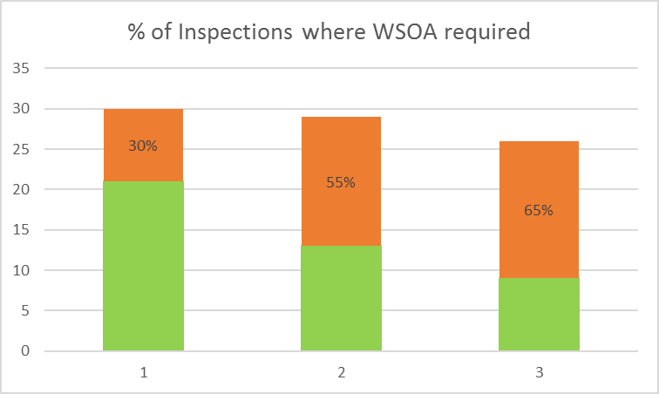
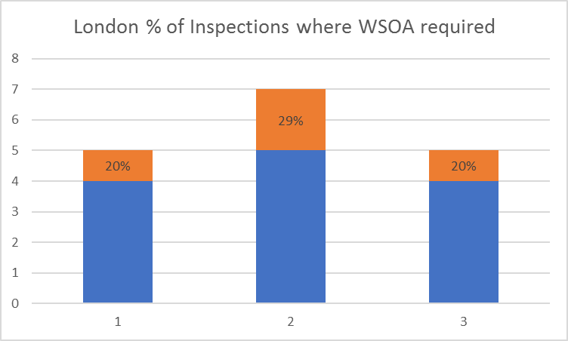
Findings from SEND Inspections
91 (out of 152) local areas inspected so far (85 reports published of which 49% have been required to produce a written statement of action
8 re-visits since December 2018 (4 reports published of which 3 had not made sufficient progress)
17 of the 32 London boroughs have been inspected, plus the City of London (17 reports published to date of which 25% have been required to produce a WSOA)
Notes:
Graph shows number of inspections on y axis and year of inspection cycle on x axis (May-April)

Slide 4
Findings from SEND Inspections
Local Area SEND Inspections: One Year On (Ofsted, October 2017)
Children and young people identified as needing SEND support had not benefited from the implementation of the Code of Practice well enough.
Children and young people who have SEND were found to be excluded, absent or missing from school much more frequently than other pupils nationally
School leaders had used unofficial exclusions too readily to cope with children and young people who have SEND
Access to therapy services was a weakness in half of the local areas inspected.
Access to child and adolescent mental health services (CAMHS) was poor in over a third of local areas.
There had not been enough progress in implementing a coordinated 0–25 service for children and young people who have SEND
Many local area leaders were unaware of the depth of frustration among local parents and what their concerns were about
A large proportion of parents in the local areas inspected lacked confidence in the ability of mainstream schools to meet their child’s needs.
Local offers were not effective in helping parents to access information and services in over half of the local areas inspected
Local area leaders have had varied success in securing the use of personal budgets

Slide 5
Findings from SEND Inspections
Ofsted Annual Report 2017/18
Continuing lack of coordinated 0-25 strategies and poor post-19 provision
Continuing trend of rising exclusions among CYP with SEND
The quality of EHC plans is far too variable
The gap in performance and outcomes for children with SEND is widening between the best and the worst local areas
Mental health needs are not being supported sufficiently
Identification of SEND is weak and those who do not quite meet the threshold for an EHC plan have poor outcomes
Outcomes for young people with SEND are often poor by age 16
Pupils with SEN support are five times more likely to have a permanent exclusion than pupils with no SEND

Slide 6
Findings from SEND Inspections
Common Key Lines of Enquiry:
Leadership and governance
Co-production with parents/carers and CYP
Identification – early years pathways, CAMHS waiting times, ASD pathway
Education outcomes
Absence and exclusions
Preparing for adulthood – transitions, pathways to employment, independent living
EHC plans – social care and health contributions, quality of plans, timeliness of plans
Joint commissioning
Use of personal budgets
Use of data – measuring impact, informing strategic plans
Vulnerable groups – CME, CLA, YOS, families from ethnic minorities or deprived areas
Local Offer
Notes:
Collated from feedback from officers involved in LBHF inspection, Ofsted annual report, and review of inspection reports.

Slide 7
Key Issues – Links with Health
Challenges:
80% of the Local Areas required to provide a Written Statement of Action in year 3 of the inspection cycle are required to address significant concerns relating to health arrangements.
Commonly the areas of concern relate to weak or ineffective joint commissioning arrangements
This area of weakness is commonly linked to poor strategic oversight by health and local authority leaders
Access to health services is a further key area of concern – particularly relating to long waiting time or inequity of access within a local area
Where a local area does not have a DMO or DCO in post this has been highlighted as a key failing
The ongoing structural changes within the NHS are providing both opportunity and challenge to building meaningful relationships
Areas of good practice:
Of the local areas that were commended on their approach to joint commissioning and delivering effective health services, common features in these local areas included:
The DMO/DCO having a secure overview of SEND (e.g. through establishing strong partnerships with other designated professionals and key strategic leaders in the local area)
Strong working relationships between health visitors, midwives, GPs and early years services to support early identification (including through co-location)
Practitioners from different teams holding joint assessments and clinics
Effective use of technology and data to support strategic planning
Consistent understanding of main weaknesses in the local area and clear plans to address these
Notes:
How can we share data more effectively with health partners to inform joint planning?
How can we make the most of structural changes within the NHS to build local relationships?
What scope is there for joint working across local area boundaries to share best practice and provide challenge?

Slide 8
Key Issues - Parental Engagement
Challenges:
71% of the local areas that were required to provide a WSOA in the third year of the inspection cycle, were required to address significant concerns relating to parental engagement.
Local areas were asked to address lacking or poor communication with parents and families
Limited co-production was noted at both a strategic and individual case level
Parents reported being unable to access information and support services
Parents reported finding it difficult or confusing to access services
An issue in a number of local areas relates to the myth that EHCP is a ‘golden ticket’
Inconsistency of knowledge and experience was also common, with some parents feeling engaged and listened to, and others not knowing how to be heard, or how to get information
Areas of good practice:
Some local areas were commended on their approach to parental engagement, common features in these local areas included:
A SEND strategy that had been co-produced with parents/carers and CYP
Frequent consultation with parents and carer to develop services – this was often facilitated by parent-carer forum (e.g. parents involved in procurement process for new hospital beds, members of PCF involved in checking quality of EHC plans and setting focus of audits)
Opportunities for parents to meet other parents (e.g. annual parent and carer conference, annual SEND information day)
Use of technology to facilitate information sharing
Training for parents (e.g. to help learn about their child’s needs while they are waiting for diagnosis)
Strong IASS and good use of mediation prior to tribunal
Notes:
How do we capture data on parental engagement? How do we report on and use examples of good practice in this area?
How can we ensure consistency of message across all services and organisations?
How can we ensure that the views of parents that we collect are representative of all parents within the local area?

Slide 9
Key Issues - High Needs Block Overspend
Challenges:
National picture of growth in need (34% increase in EHCPs in London between 2014 and 2018, with considerable variation between local authorities)
Schools being less inclusive
High cost of independent/non-maintained schools
Parental expectations
Areas for development:
Strengthening local capacity through reviewing the focus and funding of local specialist provision and developing creative local solutions
Focus on 16-25 age group and ensuring that coherent local pathways are in place
Combine HNB management agenda with SEND strategies
Ensure good use of management information
Support inclusive practices within mainstream schools
The DfE has announced a call for evidence on the funding arrangements for young people with SEND and those who need alternative provision (closing 31st July 2019).
Notes:
Why do some LAs spend considerably more on HN than others? What can we learn from those experiencing less budget pressure?
What can be done to promote greater inclusion and commitment from mainstream?
What scope is there for joint activity?

Slide 10
Priorities
Group 1
SEMH
SLCN
£
Group 2
SEN support – guidance / framework for transparency and accountability
Preparation for adulthood
Tribunals – consistency

Slide 11
PRIORITIES
Group 3
Leadership/ governance
Health experience
SEN support – attendance / exclusions /
Provision mapping
Preparing for adulthood
Group 4
Preparing for adulthood / post -16 funding / expectations
Inclusion – standard offer and approaches to SEN support
Joint commissioning - health

Slide 12
Consensus?
Inclusion in mainstream/SEN support/ exclusions/ post-16
SLCD and SEMH – managing demand/provision mapping/ assessment/ what works/ quality
Preparation for adulthood
Funding/joint commissioning
Leadership and management

