Slide 1
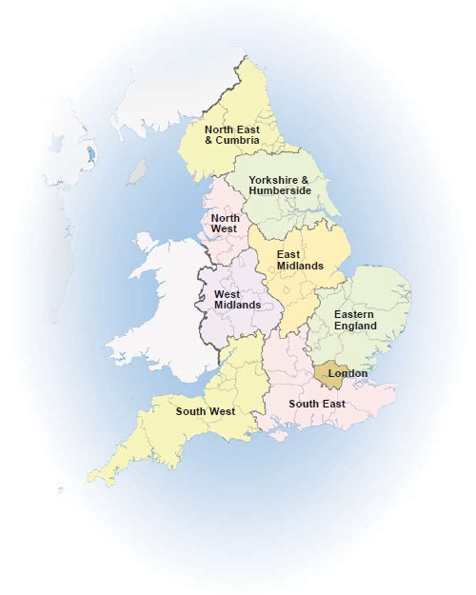
Growing Up, Moving On
The Parent Perspective
5th December 2019
Kay Moore and Fazilla Amide
NNPCF Steering Group Members, London

Slide 2
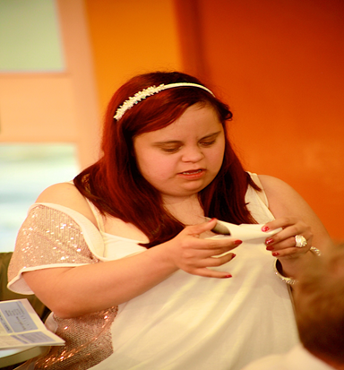
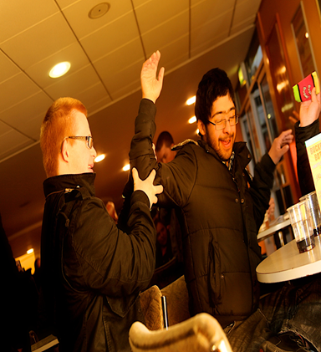
OUR ASPIRATIONS
Employment
Good Health
Independence
Friendships & Community

Slide 3
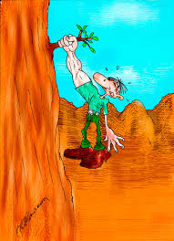
Our reality
Cliff edge
Confusion
Fear
Limited Choice & Opportunities
Young person’s voice v best interest

Slide 4
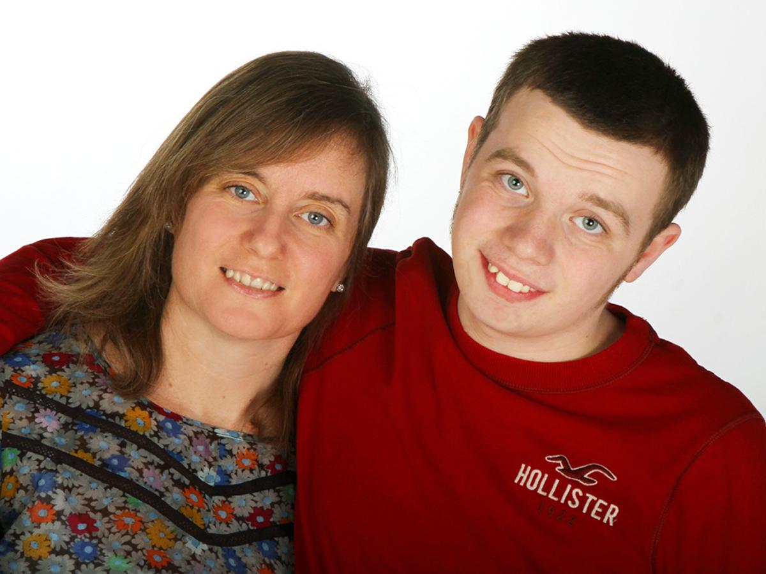
Our personal journey

Slide 5
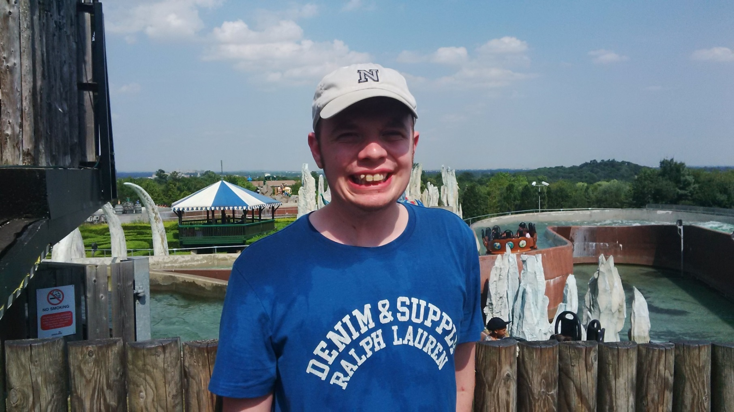
It’s all about me!
Luke’s views and wishes at the heart of our decision making.

Slide 6
KkEY
Luke is 24 and has Autism and a learning disability, manifested through his anxiety.
He is very sociable but finds it difficult to make friends and needs support to access the local community. This impacts on his social life.
As a family we are extremely knowledgeable and supportive.
As a family we want to promote Luke’s sense of well-being to support his ongoing learning, independence and wider outcomes.

Slide 7
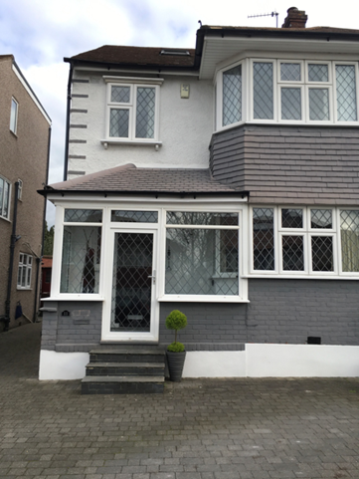
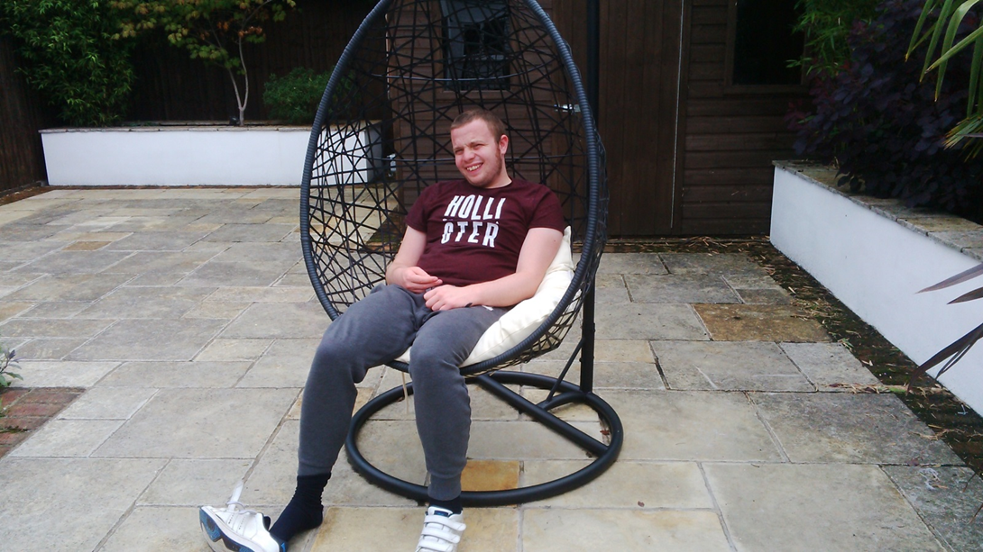
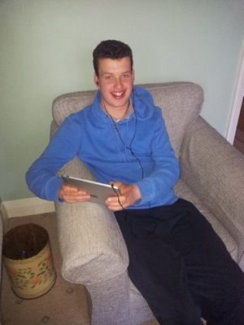
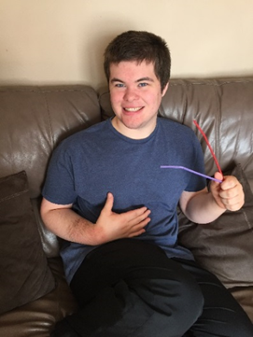
Our Aspirations
Luke to live independently with his friends in the local community.
Accessing local services and support.

Slide 8
Luke’s Outcomes
Education, Employment and training
Good Health
Understanding the broader PfA outcomes and role of EHCPs in addressing independence, friendships and accessing the local community is key.
Independence
Friendships &Community

Slide 9
KkEY
What worked well
Quality EHCP focussing on Luke’s aspirations, strengths and needs
We had supportive and person-centred conversations with Luke about his needs to promote his independence.
As a family we were willing and able to support Luke’s needs as outlined in his EHCP with help from the family, friends, the voluntary sector and statutory Social Care.
Key transitions supported by school and college

Slide 10
But…
Lack of understanding of the support required to help Luke to adjust to life outside of full time education
Lack of training, knowledge and skills of care staff to support young people with LD and autism
Lack of information regarding Supported Living model
Local Offer
Meaningful day opportunities
Personal Budget and Care contributions
Changes in benefits
Impact on ability to work

Slide 11
Transition is not just a process….
Other than the Transition process young people are going through a lot of change themselves:
Physical
Hormones
Change
Lack of certainty
Cognition
Growing awareness

Slide 12
Need a holistic approach….
System wide Joint/Integrated Services
Current system dependent often
around relationships
Health
Social Care
Families
C/YP
Education
Education
Health
Social Care

Slide 13
Findings from PCFs
Families report a number of consistent issues across the country:
Preparing for adulthood strategies and intentions, BUT provision of services is lacking across the board
Joined up working across adult and children’s services is limited in many areas
Poor planning that is not started soon enough
Information is limited and confusing both nationally and locally.
EHCPS post 19 age group
Parents report that the pathways into employment for their young people are confusing and at times difficult to access

Slide 14
Employment and Apprenticeships
https://new.enfield.gov.uk/services/children-and-education/local-offer/getting-a-job/

Slide 15
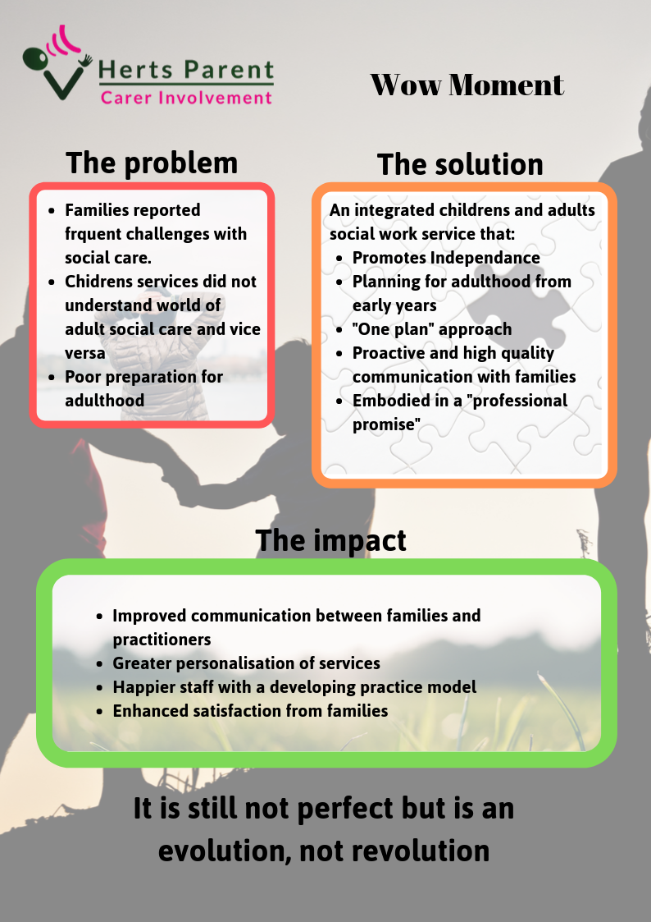

Slide 16
Notes:
High aspirations for all is a key to success.
All work being done with children and young people should bear in mind the 4 themes of preparing for adulthood:
• Education and employment
• Health and Wellbeing
• Being part of the community, having friends and relationships
• Independent living and housing options
These outcomes must be considered holistically, with the right focus on all elements to meet the personalised outcomes of each young person.
There needs to be planning by schools with parents and young people from year 9 onwards to ensure the young person gets their voice heard as well as the aspirations of their families for their future.

Slide 17
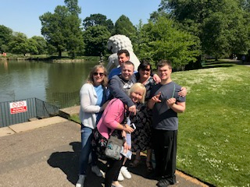
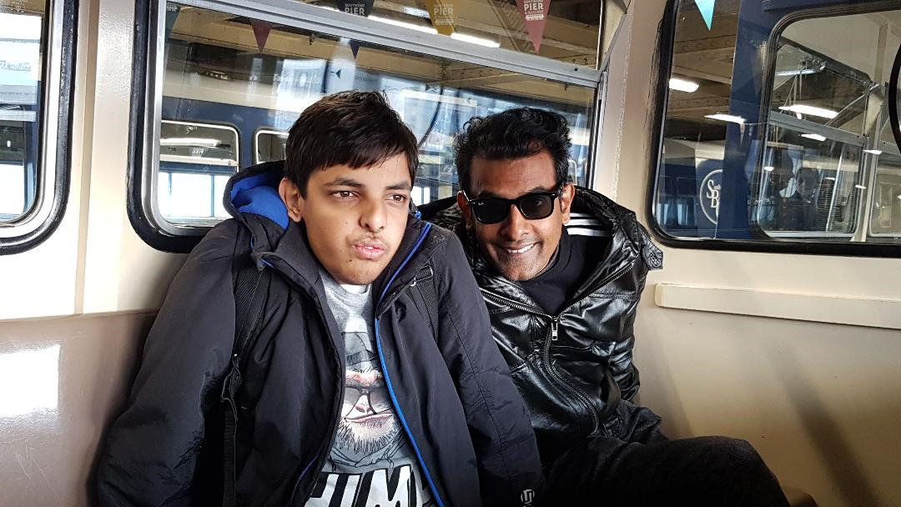
Web: www.nnpcf.org.uk
Email: london@nnpcf.org.uk

