Slide 1
Workforce Priority
Agency Push & Pull Factors
Summary of Survey
March 2022

Slide 2
Survey Respondents
Conducted in partnership with the South East region
75 respondents
65% of respondents from London
75% of respondents were female
57% of respondents were Black, Asian or Ethnic Minority

Slide 3
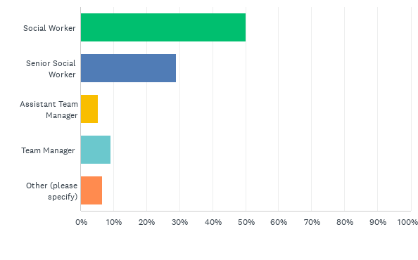
Q2: Which of these positions best describes your role?
Answered: 76 Skipped: 0
50% of respondents classified as Social Worker level

Slide 4
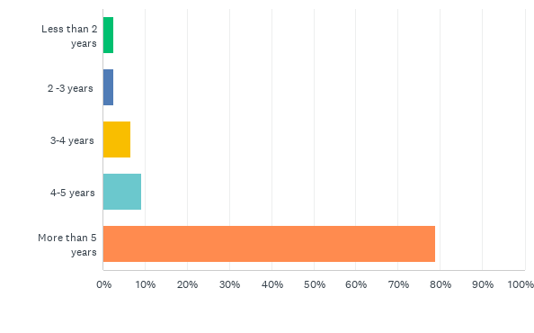
Q3: How many years post-qualified experience?
Answered: 76 Skipped: 0
79% of respondents had over 5 years PQ experience

Slide 5
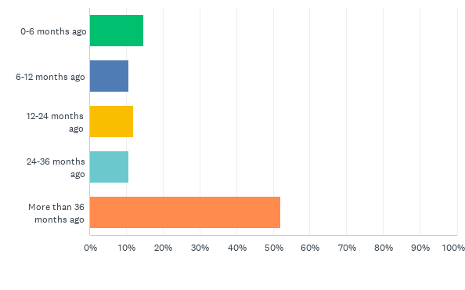
Q6: When were you last in a permanent role?
Answered: 75 Skipped: 1
52% of respondents has not been in a permanent role for over 3 years

Slide 6
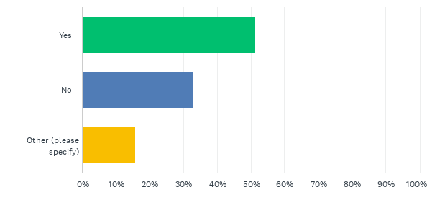
Q7: Do you think that you might look for permanent employment with a Local Authority in the field of Social Work in future?
Answered: 76 Skipped: 0
51% of respondents said they intended to look for a permanent role within a Local Authority in he future

Slide 7
Comments on converting to permanent
yes but not yet, I'm looking to find the right role
If the environment was right e.g., strong supportive management structure.
Considering options at the moment
I would like to think so if it’s beneficial to me
I have tried to use my LAs agency absorption policy to be employed into a SW role that I’ve have held since 2017 and have been unsuccessful in doing so due to a lack of clarity from line management.
Dependent - only if the role is career progressive
Yes I would like to apply for a permanent post and plan to do this in April 2022 when I finish my year employment at Islington Council.

Slide 8
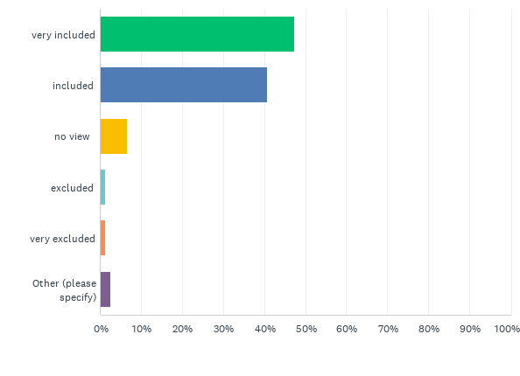
Q9: As an agency worker, to what degree do you feel included within the Children’s Social Worker workforce as a whole?
Answered: 76 Skipped: 0
88% of respondents reported feeling included or very included in the workforce

Slide 9
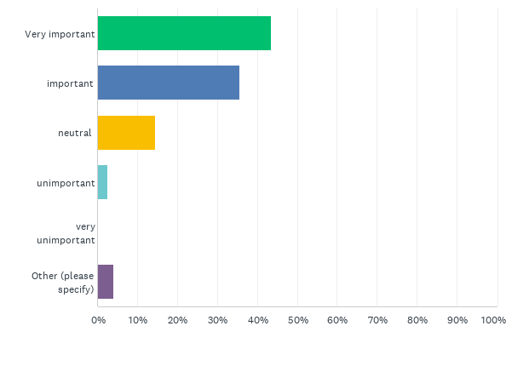
Q10: To what degree does money play a role in your decision to work as agency?
Answered: 76 Skipped: 0
77% of respondents stated that money plays a significant role their decision to work agency

Slide 10
Comments on money as a driver
This varies rom LA to LA. Most I have felt excluded. However there ha been a few who have treated agency workers the same as they do perm workers.
Was important at the start of my agency journey and is now less important but still a factor
Money is roughly the same

Slide 11
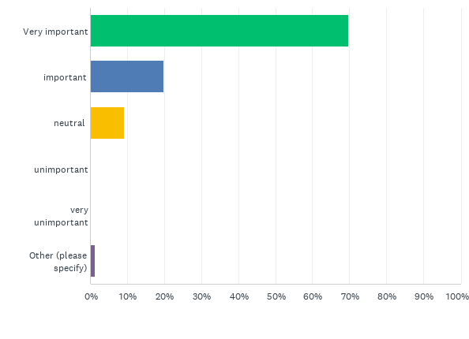
Q11: How important is your immediate supervisor (manager/team leader) to your commitment to staying within a role or organisation?
Answered: 76 Skipped: 0
90% of respondents stated that their immediate manager is important or very important in their decision to stay in a role or organisation

Slide 12
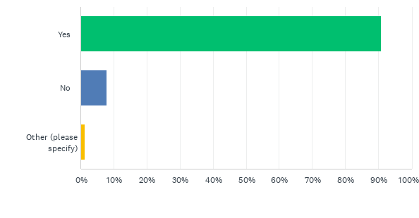
Q12: Is flexibility an important factor in your decision to be an agency worker?
Answered: 76 Skipped: 0
91% of respondents stated that flexibility is an important factor in the decision to be agency

Slide 13
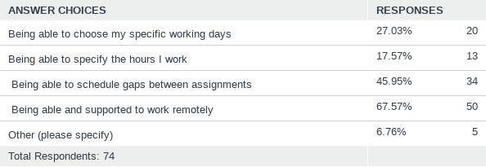
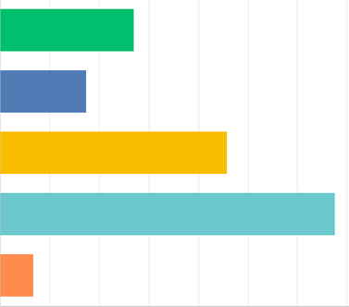
Q13: What aspect of flexibility matters to you most?
Answered: 74 Skipped: 2

Slide 14
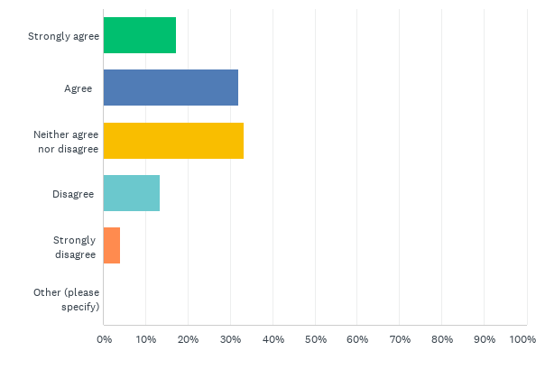
Q14: Statement “Working as an agency worker allows me to better develop and progress my career in Social Work”.
Answered: 75 Skipped: 1
49% of respondents agreed or strongly agreed that agency work was beneficial to their career development and progress

Slide 15
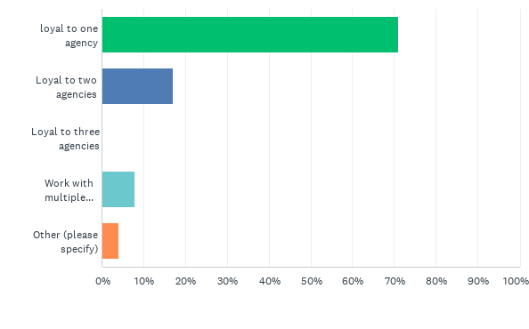
Q15: Are you loyal to one agency or do you engage with several concurrently?
Answered: 76 Skipped: 0
71% of respondents stated loyalty to one recruitment agency

Slide 16
What SUPPORT & BENEFITS does your agency provide?
Looking for roles and advertising on my behalf
Prompt communication
Good support
Free training and workshops to contribute to CPD
Agreed living expenses with the council.
Provision of training and obtaining vacancies
They advise me about opportunities
Referral bonus
Paid for training
Support negotiating terms of working
None.
Negotiating roles on my behalf
Ensures that there are no difficulties and that the placement is working well for me.
It’s really is about the money. SW does not pay well for the work that we do.
Bonus if I complete a certain amount of working hours.
They offer a list of trainings usually twice a year.

Slide 17
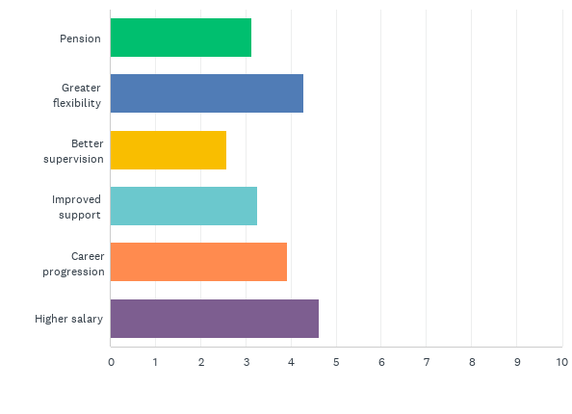
Q18: What would ultimately entice you to convert you to a permanent role within Local Authority Social Work (please rate in order of importance 1 = most important)
Answered: 73 Skipped: 3
Higher salaries and greater flexibility featured as the two most popular enticements to move to a permanent role

Slide 18
Additional Comments
I think permanent social workers are underpaid
Agency workers are always expected to perform at a better standard than perm staff as you are always reminded that you are replaceable. This can be de-valuing.
Some local authorities are very negative towards agency workers.
Can't help but notice that the majority of attendees [to the focus group] appeared to be black. Interesting that we all shared similar experiences of feeling marginalised. I'm not hopeful that things will change as years ago the Equal Opportunities Policy was the fashionable initiative with this hope of change.
Manageable case load are essential
I have applied for permanent roles in the past and not got them because the Service Manager clearly had their own ideas.
Agency staff can be better cared for as they have such short notice periods, they don't want you to go. I also think that there is a greater emphasis on treating Agency workers better (offering them toil and longer contracts).
I would like to apply for permanent role but the processes are to difficult- do online application, do two complex interviews .

