Slide 1
1
HEALTHY RELATIONSHIPS AWARENESS
Edge Of Care
Public Service | Standing together in Waltham Forest

Slide 2
2
HEALTHY RELATIONSHIPS AWARENESS WORKSHOP
Aim of session
Is to raise awareness and understanding of what constitutes a healthy relationship
To explore signs of unhealthy relationships.
Public Service | Standing together in Waltham Forest

Slide 3
3
Who are we?
Public Service | Standing together in Waltham Forest
Notes:
Mention what EOC do e.g. activities such as gym, boxing, restaurants etc
Promote healthy relationships. Strengthen relations

Slide 4
4
Healthy Relationships
Public Service | Standing together in Waltham Forest

Slide 5
Parent/child Relationships
5
Communication: communicate with your child in a fair, assertive and friendly manner and listen actively.
Voice of the child: listen to your child.
Love: display affection and warmth towards your child and use words of affirmation.
Trust: earn your child’s trust.
Respect: treat your child as an individual and acknowledge their opinions and beliefs. Respect their views so that they respect you.
Spending Time: sends child message they are important, makes them feel good, builds self-esteem, enhances parent/child relationship.
Model responsible behaviour: your child will imitate what they observe.
Awareness of developmental stage: children develop in many different ways: mentally, emotionally, physically and socially.
Public Service | Standing together in Waltham Forest
Notes:
An understanding of where your child is developmentally can enhance parental understanding of child’s behaviour/actions

Slide 6
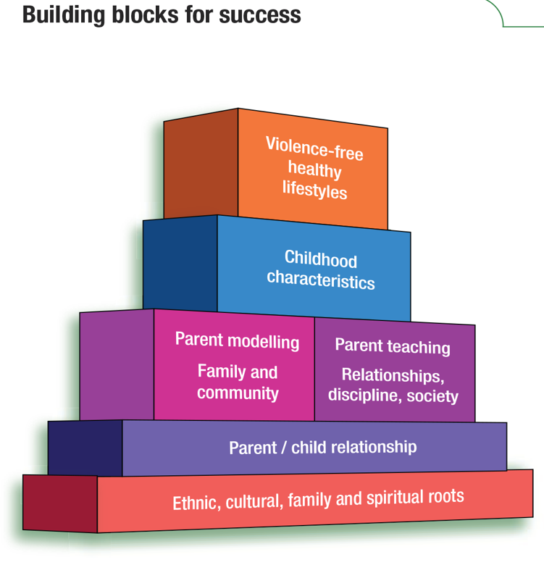
6
Parents should respond to child’s behaviour instead of reacting to it.
Parents should view discipline as teaching.
Positive teaching and communication.
Most powerful teaching tool. Parents need to model expected behaviours.
Consider influences from the community.
Special time,
Recognise their unique characteristics –personality, temperament
An awareness of child’s developmental stage
This values the idea that parents and children must strengthen positive family/ cultural roots.
Public Service | Standing together in Waltham Forest
Notes:
The building blocks demonstrates the different areas are related and how they can enhance the parent/child relationship
Foundation
Parent child relationship major influence on how children feel about themselves self-esteem. Positive parent child able to teach right from wrong
Family and community interralated
Process of discipline – variety of techniques SFSC see d

Slide 7
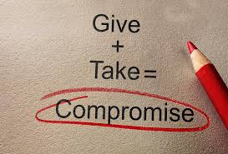
7
Healthy Relationship and Mental Wellbeing
Relationships are one of the most important aspects of our lives. People who are more socially connected to family, friends, or their community are happier, physically healthier, and live longer, with fewer mental health problems than people who are less well connected.
It’s not just the number of friends you have, and it’s not whether or not you’re in a committed relationship, but it’s the quality of your close relationships that matters. Living in conflict or within a toxic relationship is more damaging than being alone.
Public Service | Standing together in Waltham Forest

Slide 8
8
Healthy Relationships Online
Like relationships conducted in real life, online ones should be based on qualities such as friendship, kindness, respect, trust, support, loyalty, equality, empathy, compromise and consideration for other people’s feelings.
The nature of the internet means evidence of unhealthy or abusive
behaviour can easily be hidden from public view, via private messages or
profiles. This may isolate the other person from family and friends and cut them off from receiving support. It is therefore crucial that young people know of routes to get support from and that their voice will be listened to.
Public Service | Standing together in Waltham Forest

Slide 9
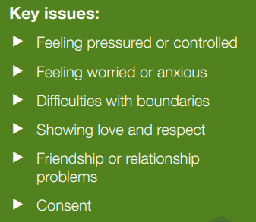
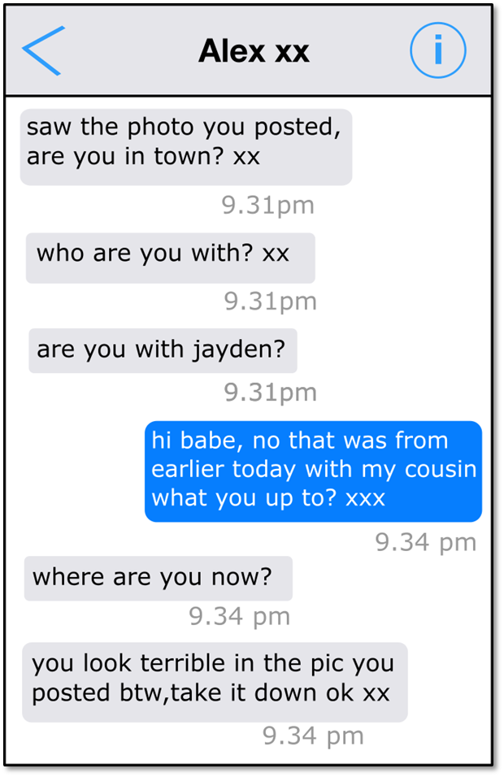
9
Healthy Relationships Online
What type of relationship is this?
What would be your thoughts if you saw this on your child’s phone?
Public Service | Standing together in Waltham Forest

Slide 10
10
Healthy Relationships Online
Try to keep laptops and device use in public spaces.
Pay an interest in what your child is doing online.
Use parental controls to set time limits and restrict access to certain sites.
What can parents do?
Public Service | Standing together in Waltham Forest

Slide 11
11
Recognising Unhealthy Relationships
Public Service | Standing together in Waltham Forest

Slide 12
Agree or Disagree Statements
12
Recognising Unhealthy Relationships

Slide 13
An unhealthy relationship Isolates you from friends and family
13
Recognising Unhealthy Relationships

Slide 14
Someone telling you where you can go and whom you can see is part of a healthy relationship
14
Recognising Unhealthy Relationships

Slide 15
Your thoughts and opinions are not important in a healthy relationship.
15
Recognising Unhealthy Relationships

Slide 16
Hurting your feelings, putting you down is acceptable in a healthy relationship
16
Recognising Unhealthy Relationships

Slide 17
Taking time–out from work, college and family commitments for a friend. can be a healthy relationship
17
Recognising Unhealthy Relationships

Slide 18
18
Signs of unhealthy relationship
Be aware of abuse indicators:
Signs of physical abuse include:
Being wary of adults, unable to play, being aggressive or abusive, bullied by other children or the bully themselves, unable to concentrate or achieve in / at school, lying and stealing.
Signs of sexual abuse include:
Sudden change in behaviour, thinking badly of themselves, not looking after themselves, using sexual ideas or talk in their play / conversations, starting to wet or soil or ignore personal hygiene, underachieving at school, behaving flirtatiously, being fearful of physical contact, becoming depressed, self-harming, running away.
Signs of emotional abuse or neglect include:
Being slow to learn or engage with their personal development, being very passive, not eating regularly or healthily, having difficulty in developing close relationships, getting on badly with peers, being unable to play imaginatively, having a poor self-image, doing badly at school.
Public Service | Standing together in Waltham Forest

Slide 19
19
Signs to look out for Parents / Carer
Risk/ Warning Indicators
Frequent missing episodes/being found out of the area
Unexplained amounts of money, mobiles, clothing, jewellery, new hair-cut, other items gifts
Change in behaviour; more secretive / withdrawn/ isolated from peers/ use of sexualised language
Unexplained absences and disengagement with ETE
Increasing use of drugs or / and alcohol
Fear of reprisals/ violence from young people or adults
Entering or leaving cars with unknown adults
Repeated STIs (sexually transmitted infections )or pregnancies
Public Service | Standing together in Waltham Forest
Notes:
Related to grooming

Slide 20
20
What can I do?
Provide a safe, confidential environment for them to talk to you Listen to your child and accept what they are telling you.
Tell your child what you are going to do, what is going to happen next, and who else they will need to talk to e.g. Police; doctor; social worker etc.
Report to the police as soon after you’ve been told about the abuse so the details are fresh in your mind and action can be taken quickly. It can be helpful to take notes as soon after you’ve spoken to the child. Try to keep these as accurate as possible.
Once you have reported to the police, the police will start an investigation
Relevant professionals will be notified- e.g. school, social care, doctor etc. Your child will be supported throughout this whole process by a team of professionals.
Public Service | Standing together in Waltham Forest

Slide 21
21
Public Service | Standing together in Waltham Forest

Slide 22
22
Pace
Supports parents and carers whose children are being exploited by offenders outside of the family.
https://paceuk.info/
Report non-emergencies by calling 101
Advice
Kooth
Online mental wellbeing community.
Free online counselling & support for Young People.
www.kooth.com
Sexual health
Team Manager- Jacque King. Jacque.King@walthamforest.gov.uk

Slide 23
23
Contacts
Children's Social Care [MASH team] /CSC: Emergency Duty Team (out of hours) – 0208 496 3000
Report non-emergencies by calling 101
Sexual health Team Manager- Jacque King. Jacque.King@walthamforest.gov.uk
RISE- www.risemutual.org – Supports YP to live a safe and fulfilling life, protected from all forms of harm, including abuse, bullying, exploitation and violence.
Helpguide.org
Relate.org
www.kooth.com – Free online counselling & support for Young People
https://paceuk.info/ - We support parents and carers whose children are being exploited by offenders outside of the family.
Young Minds - 020 7089 5050 – Information/Support on Mental Health for Young People
www.nspcc.org.uk
https://thebeyouproject.co.uk/resources/
https://mermaidsuk.org.uk/
Notes:
Rise –
Relate-

