Slide 1



"Your Choice"- Enhanced CBT Practice
Practitioner Training
Prepared by Dr Karla Goodman (LIIA, Director of Practice)
© LIIA (London Councils) 2022. All rights reserved. These materials may not be reproduced or distributed other than in accordance with the Your Choice Programme, without express permission.

Slide 2
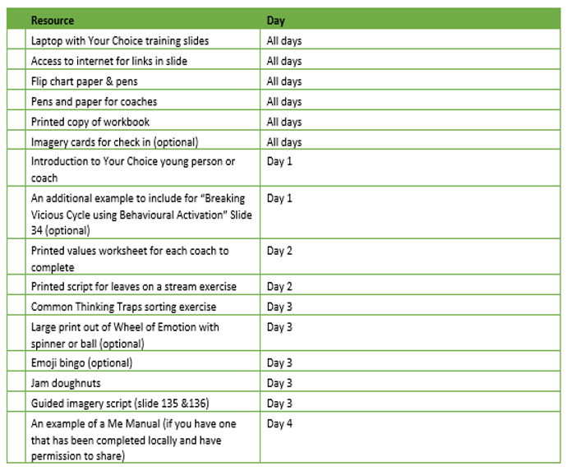

Slide 3

Day 1

Slide 4

On a scale of 0-10 how confident are you in delivering a CBT informed intervention, which focuses on behavioural activation, to young people?
Notes:
You may wish to use post it notes- with name so that you can compare with post scores at the end of the training.

Slide 5

Notes:
You might want to encourage coaches to start their own A-Z from the training- noting key words or new words as they go, that link to the programme.
You may also want to check in with coaches at regular intervals i.e. before breaks- name three things that they have learnt in the session.

Slide 6
Taking care of yourself
You may find yourself triggered or reflective of your own experiences or patterns during the course of the training but also when you are delivering the programme.
It’s ok. You’re human too but it is really important to make good use of your own supervision to talk things through with your supervisors.
Self care is important. Try to ensure that you have time for you after a long day’s training. Throughout the course there will be opportunities to practise some of the techniques that you will be encouraging your young people to use. You’re free to use them whenever you wish!

Slide 7
Taking care of yourself
What do you need from me, yourself and each in order to feel safe and contained throughout the training?
Notes:
Setting some ground rules will be important. Recommend displaying this throughout the sessions.

Slide 8
Training programme overview
Day One
Day Two
Day Three
Day Four
  The who, the what and the why.
  An introduction to CBT.
  The “T” in “Your Choice”
  The “B” bit. An introduction to Behavioural activation
  Exploring values and identifying goals.
  Dealing with difficult/ intense emotions.
  The “C” bit. Understanding how thoughts impact on behavior and strategies for dealing with this.
  Bringing it all together
  Reflections- putting theory to practice.
  Case study presentations
  Preparing for endings.
  “My Guide” manual.

Slide 9
Overall Learning objectives
By the end of the training it is hoped that you will….
  Know what the Your Choice programme is.
  Have an understanding of the underlying principles of CBT and how this approach can be helpful in your work with young people at risk of harm or vulnerability.
  Be familiar with the Guiding Principles of Your Choice.
  Understand the link between activating events, thoughts, feelings and behaviours.
  Think creatively about goal setting and how to identify and manage problematic thoughts, feelings and behaviours that “get in the way”.
  Be open and committed to understanding unique and diversity factors that influence each young person’s engagement, their presentation and their behaviour.
  Be familiar with a range of CBT exercises that can be adapted and used with young people to help them to achieve their goals.
  Be aware of the importance and impact of therapeutic processes and the importance of clinical supervision.
  Stay awesome and continue to champion for our young people in your area.
Notes:
Introduce the various methods that will support learning i.e. combination of teaching, group discussion, immersive exercises.
Invite learners to share ideas suggestions that will help you to help them to achieve objectives
what do they need from you as trainer?
What do they need from other learners?

Slide 10
Learning objectives Day One
To understand what Your Choice is and understand the “Why’s” of the programme.
To understand what CBT stands for, what it is and why we think it will be helpful in your work with young people.
To be aware of therapeutic skills that are important to hold in mind.
To explore what it means to be culturally sensitive in your work with young people.
To introduce the 5 factor model of CBT and behavioural activation.
Notes:
This slide specifically outlines the objectives for Day 1

Slide 11



There will be signs….
Group exercise
Available in the resource pack
Case study exercise
Notes:
Symbols may appear on the slides which signify the following

Slide 12
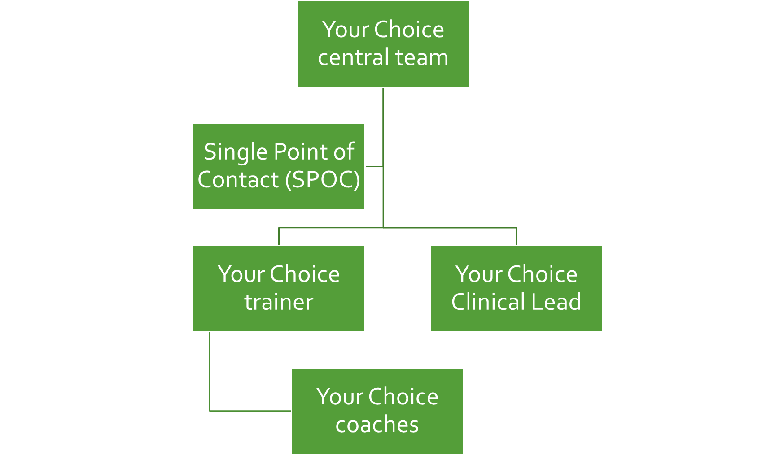
Notes:
In each locality there are a number of Your Choice key players who are supported by the Your Choice central team at LIIA.

Slide 13
SPOC Responsibilities
Co-ordinate and implement the Your Choice training and programme locally, ensuring that local processes and procedures enable accessible and inclusive training and practice.
Central communication point between delivery site and the Your Choice central team, including reporting any complaints relating to the programme (NB- delivery sites are expected to follow local complaints protocol but to notify central team of complaint and outcome.
Ensure appropriate resourcing of staff (including trainers, clinical leads and coaches), IT, and training.
Participation in SPOC-focused induction training and 1-1 sessions.
Ensure appropriate access to Your Choice password protected areas on the LIIA website for all local staff.
Engage with Your Choice Central team to provide case studies and other ad hoc data collection.
Manage relationship and integration with other comparable programmes such as Vanguard if applicable.
Ensure completion and submission of Your Choice Annual Report to the Your Choice Central Team.
Ensure Trainer and/ or Clinical Lead is appropriately qualified for role.
Ensure that Clinical Leads, Trainers and Coaches are aware and compliant with their respective roles and responsibilities.

Slide 14

Trainer role and responsibilities
Qualifications and experience
A good understanding of mental health difficulties prevalent amongst children likely to have experienced early trauma and Adverse Childhood Experiences (ACE’s), and their varied presentation in this age group.
Good working knowledge of CBT, the underpinning principles and techniques that address thoughts, feelings or behaviour that may be impacting on an individual’s goals.
Experience of delivering therapeutic interventions in clinical settings.
Registered with a professional body such as HCPC, BACP, UKCP & Social Work England.
Responsibilities
Your Choice trainers are responsible for the local delivery of Your Choice training, ensuring it is delivered in line with Your Choice principles, training objectives and materials, as well as relevant local policies and procedures, including safeguarding, equality and diversity, and complaints processes.
Your Choice trainers will have clinical expertise and experience in the use of Cognitive Behavioural Therapy (CBT), to inspire, inform and upskill Your Choice coaches in the use of CBT tools and techniques that can be creatively weaved into existing practice and enjoyable activity.
Your Choice trainers are expected to complete the certificated 2 day Your Choice Train the Trainer Training in order to deliver the 4 day Your Choice Training to Your Choice coaches.
Trainers are responsible for ensuring that training is delivered in a way that is accessible and inclusive in accordance with the responsibilities outlined in the Your Choice Inclusive Training Guidance. This includes making reasonable adjustments and adaptations as required. This should be reviewed through Equal Opportunities monitoring form and feedback from learners including through evaluation forms and included in Your Choice Annual Review Report.
To become a certified Your Choice Trainer, Trainers are also expected to host an observation session with the Your Choice central team and a minimum of 2 Clinical Lead Network sessions to support ongoing learning and development.
Trainers are required to certificate Your Choice Coaches upon completion and evidence of i) attendance at 4 day Training ii) Completion of Quiz iii) attendance at a minimum of 4 Your Choice Clinical Supervision sessions (post training).

Slide 15
What is a Your Choice Clinical Lead?
Your Choice Clinical Leads are those with clinical expertise in Cognitive Behavioural Therapy (CBT). Our Clinical Leads provide clinical supervision for our Your Choice coaches/practitioners.
Qualification & experience
A good understanding of mental health difficulties prevalent amongst children likely to have experienced early trauma and Adverse Childhood Experiences (ACE’s), and their varied presentation in this age group.
Good working knowledge of CBT, the underpinning principles and techniques that address thoughts, feelings or behaviour that may be impacting on an individual’s goals.
Experience of delivering therapeutic interventions in clinical settings.
Registered with a professional body such as HCPC, BACP, UKCP & social work England.
Clinical Leads are expected to complete Your Choice Train the Trainer Training prior to practicing in their role as Clinical Lead.

Slide 16
What is a Your Choice coach?
Your Choice coaches are youth practitioners who are specially trained to creatively weave in Cognitive Behavioural Therapy (CBT) tools and techniques into their existing practice with young people.
Your Choice Coach Responsibilities
Complete 4 day Your Choice Training and Your Choice supervision with Your Choice Clinical Lead once a month.
Use their existing knowledge and skills and those learnt from their Your Choice training to creatively weave in CBT tools and techniques into their practice with young people.
To assist young people to explore their guiding values and to use these to identify goals and aspirations that are meaningful to them.
Creatively weave in CBT tools and techniques to support young people to achieve their goals and overcome challenges that may get in the way of achieving them.
Consider and support each young person and their professional and wider networks to understand how Your Choice goals and programme interacts with existing intervention, to ensure that the programme is well co-ordinated and informs and is informed by intervention, risk and vulnerability plans.
To support each young person to identify and activate a network of support that can enable the intensive component of the programme- to ensure that young people have the time and support to activate and nurture pro social activities, behaviours and networks during and beyond the Your Choice programme.
To ensure that any safeguarding concerns are escalated in accordance with local protocol, which may include notification and advice from line manager or Designated Safeguarding Lead.

Slide 17
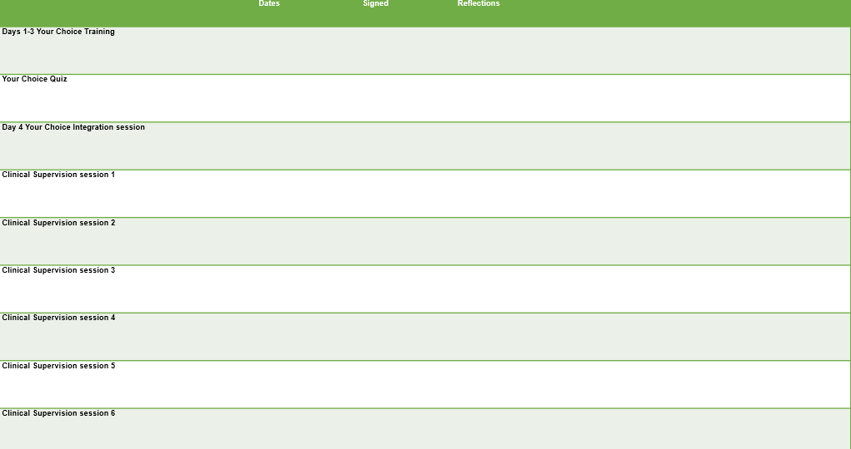
How to become a certified Your Choice Coach
Your Choice recognises that learning only begins in the training room and that developing new skills requires effective consolidation by applying them in professional practice. Your Choice coaches are, therefore, required to participate in monthly supervision to support their ongoing learning and professional development.
To become a certified Your Choice coach you must complete and evidence the following in your logbook;
  4 days Your Choice Training
  Your Choice Quiz
  Attendance at 4 supervision session
Once complete, coaches should present logbooks to their trainer who will issue Your Choice certificate, which we are hoping will be approved as part of the British Psychological Society kitemark scheme.

Slide 18

Your Choice- Background
Sequentially funded by Home Office, VRU and Youth Endowment Fund in London from 2021
Currently delivered by local authority adolescent services
Rigorously evaluated by IFS and Anna Freud Centre through a Randomised Control Trial
Anecdotal and emerging evidence demonstrate positive impact on young people including improved pro social behaviours, reduced conduct and emotional problems.

Slide 19

Children and young people most affected by violence are the ones who most need therapeutic support but are currently the least likely to get it.
This is what Your Choice aims to change.
Notes:
Why was Your Choice developed?
We need to find a way of delivering effective interventions to support their wellbeing. We need to make the interventions work for them rather than relying on them to adapt to interventions that do not feel accessible.
It might be helpful to generate a discussion here about the reasons behind this- what are the things that impact access to clinical services. Encourage coaches to hold these in mind as they are planning/ working through the training and programme.

Slide 20
The "Your Choice" Framework
A framework developed for local authorities, which supports their youth practitioners to integrate CBT tools and techniques in their work with vulnerable young people.
This framework is rooted in:
Multi-agency working practices (e.g. referral routes).
Current best practice in adolescent safeguarding, using a public health approach
Response to current presentation, not a requirement to wait until fit criteria
Upskilling practitioners & young people alike; to take young people on journey of “guided discovery” and equip them with tools and techniques that can be useful in overcoming a range of psychological challenges
Range of psychological theory including developmental, trauma and neurological theory and best practice in relation to adolescent safeguarding.
Notes:
What is Your Choice.

Slide 21
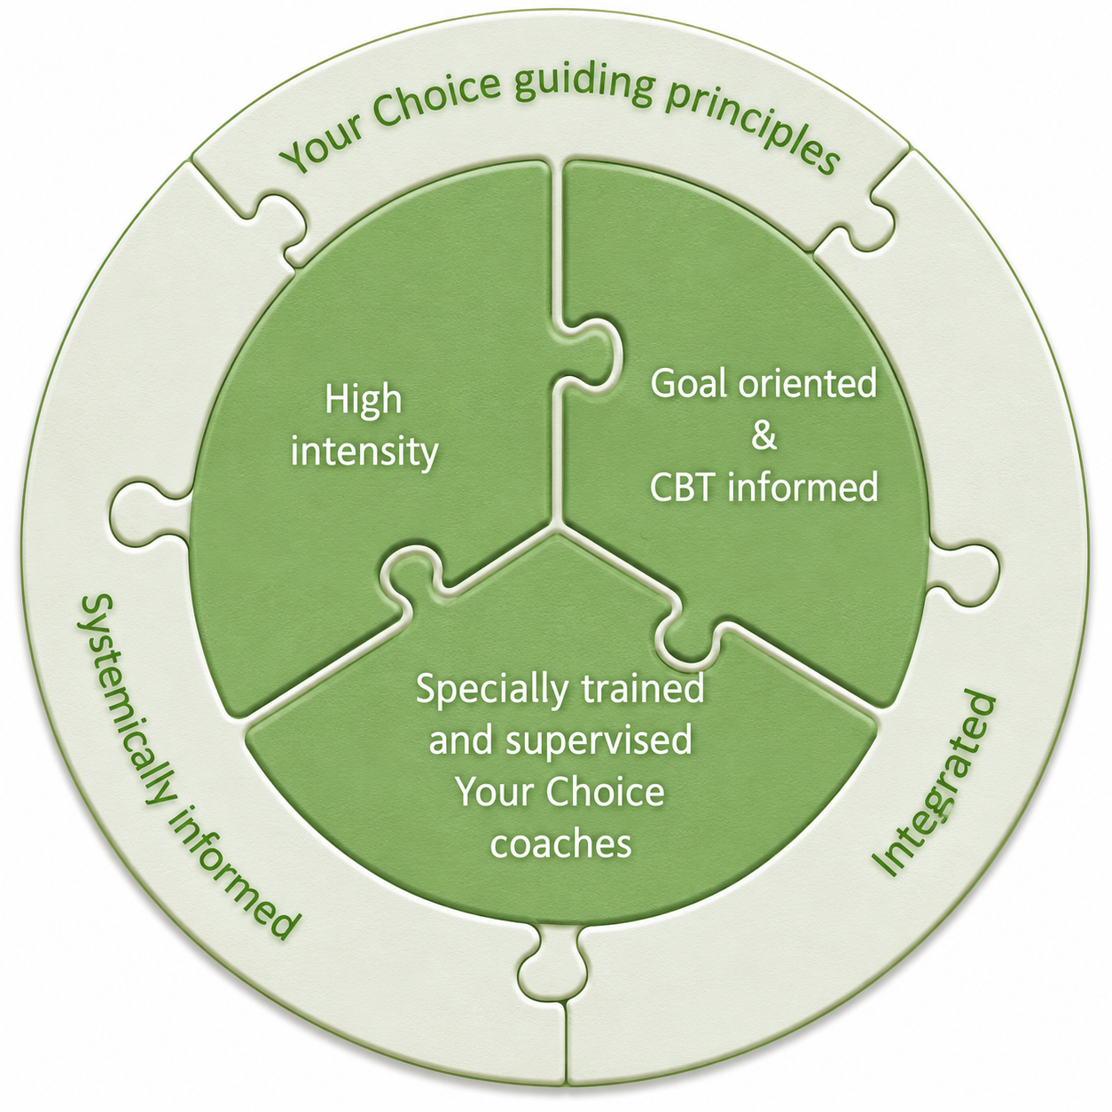
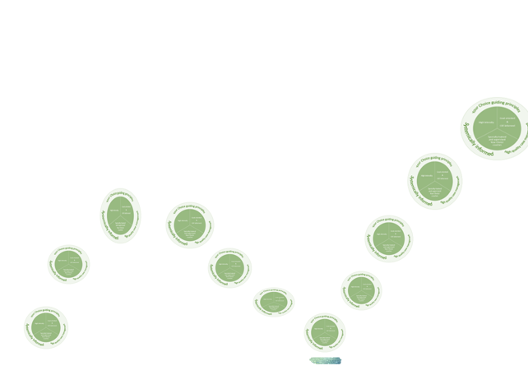
Your Choice Core components
Notes:
What is Your Choice.
Your Choice is designed to be flexible and agile- to meet the needs of the individual- but there are 3 core components that make up the programme
High intensity approach
Goal oriented and CBT informed
Provision of specialist training and supervision for all coaches.

Slide 22

Notes:
Your Choice requires professional agility- hence importance of built in supervision to help you to stay match fit and agile.

Slide 23

What is Your Choice? (youtube.com)
Notes:
Video- explainer- which you can use to explain programme to young people, parents, professionals and anyone in young person’s network that they identify as important in supporting them to achieve their goals.

Slide 24
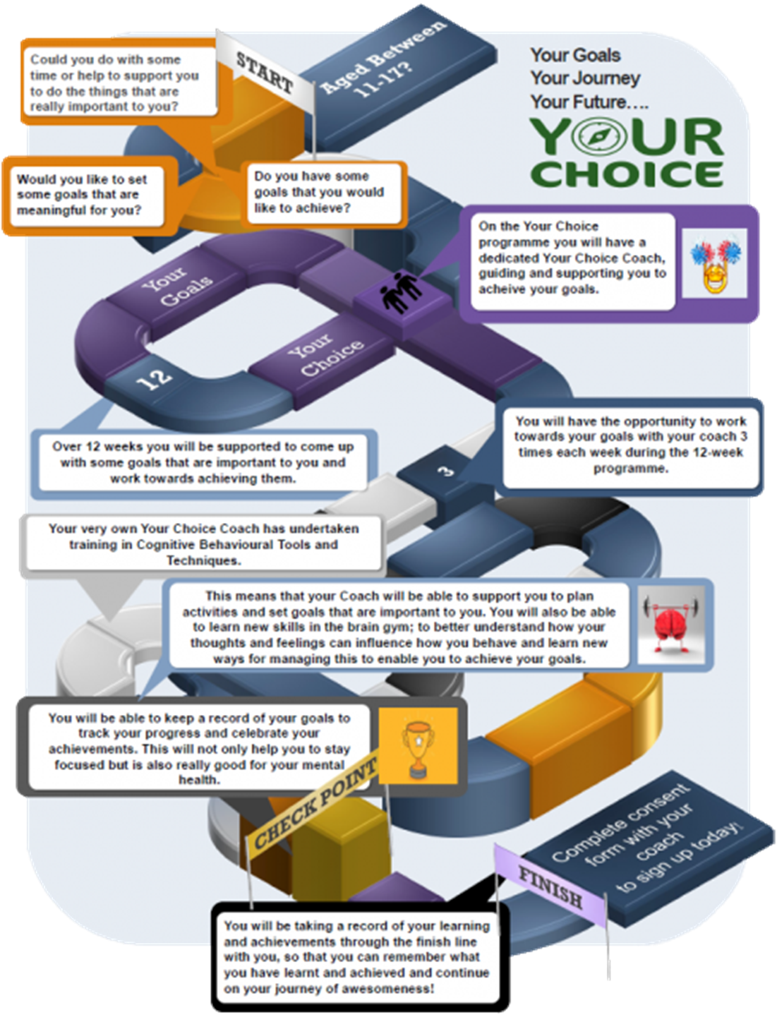
Notes:
A visual that you can share with young people which demonstrates the journey through the programme.

Slide 25


What is Your Choice?
Notes:
As described by our practitioners.

Slide 26
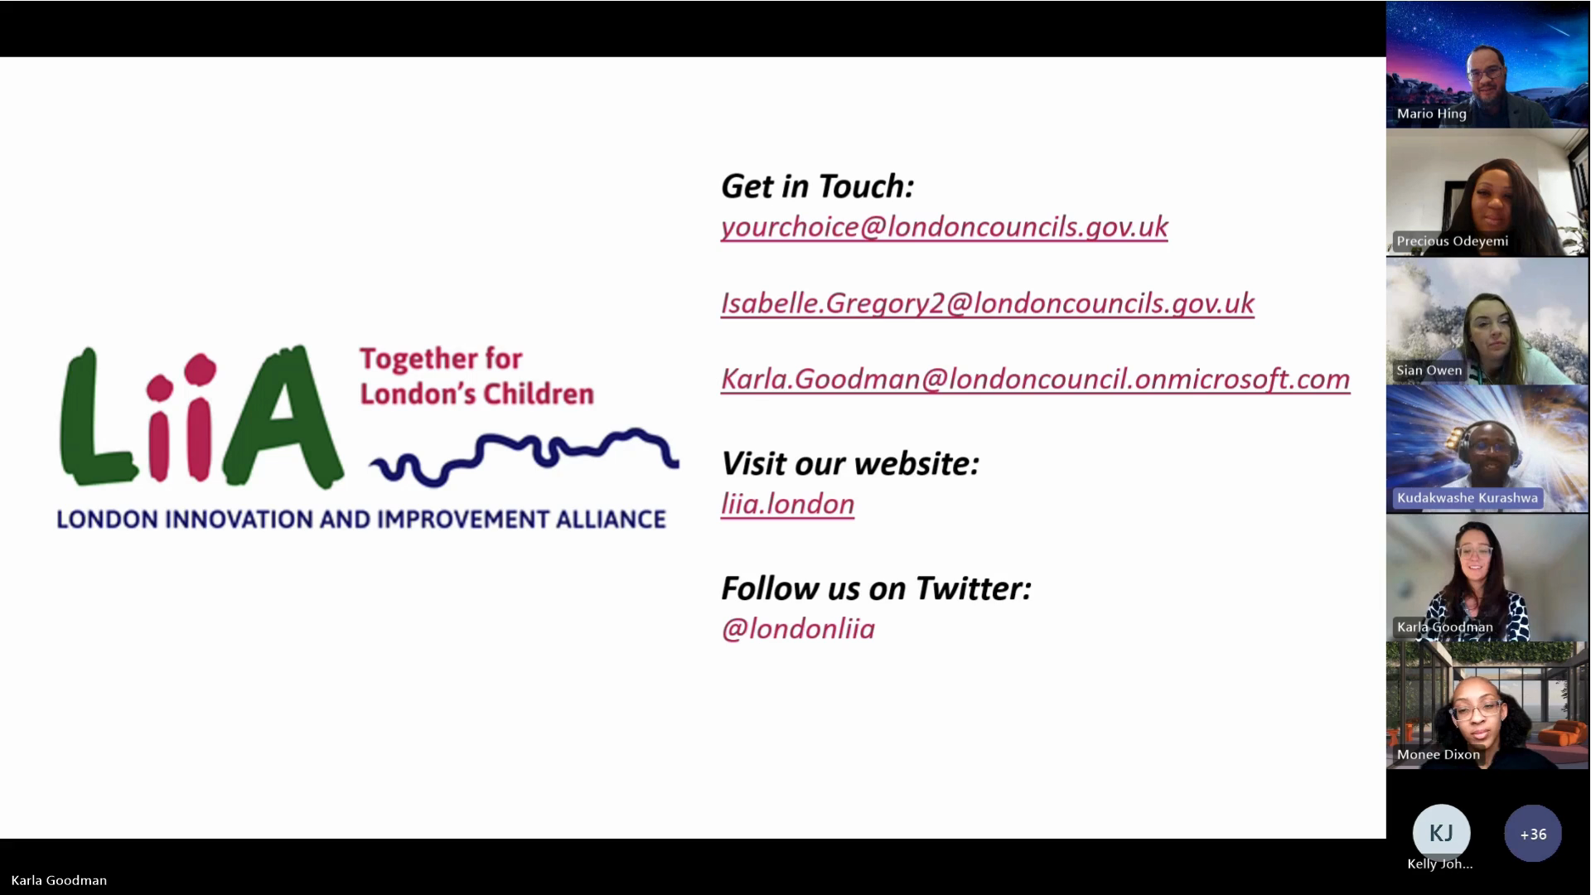
Your Choice in Hillingdon “It gives us hope”.
Notes:
As described by Team Manager in Hillingdon

Slide 27
Who’s eligible for Your Choice & LYPS?
  Young people aged [as identified in Logic model]
  Young people open to [insert team name ]
  Young people assessed as medium- high risk of harm outside of the home [or as agreed in logic model]
  Young people discussed at Multi Agency Referral Panel [or as agreed in logic model]
Notes:
To be updated locally

Slide 28
Why them?
Young people referred to multi agency panel (this cohort) are likely to have experienced early childhood trauma and experienced or experiencing Adverse Childhood Experiences. Neurodivergence is also common.
Consequently this cohort are more likely to find it difficult to recognise and manage different emotions and behaviour and are at increased risk of presenting in distress and developing mental health difficulties (Sweeney, Clement, Filson & Kennedy, 2015).
Lack of availability, poor information, inflexibility, complicated referral processes, cultural barriers and stigma impact on young people's access to clinical services.
Young people in this cohort are therefore likely to benefit from opportunities, tools and techniques to improve their mental wellbeing delivered in a way that is accessible to them.

Slide 29
The Your Choice cohort
  Neurodiverse young people (diagnosed and undiagnosed) and young people with attachment difficulties and those who have experienced trauma are likely to be over represented in the Your Choice cohort.
  This is because cognitive, social and emotional traits associated with early adversity and specific neurodevelopmental disorders increase the propensity for “risky” behaviour.
  Young people who have experienced early trauma and those with neurodisability experience lower levels of mental wellbeing, which can be bolstered by pleasurable activity and techniques available through the programme.
  (Brooks, Rob & Lambert, Charlotte & Coulthard, Laura & Pennington, Lindsay, Kolehmainen & Niina,2021).
Notes:
NB Neurodiversity within this cohort may not always be diagnosed due to accessibility of clinical services it is important to recognise that some young people may not have a diagnosis but may still display difficulties with concentration, understanding, or behaviour that impact their ability to engage.

Slide 30
The Your Choice cohort
Neurodiverse young people and those who have experienced early trauma are likely to;
Interact with people differently and benefit from help understanding other people’s language and behaviour
Have different sensory needs, which mean that they experience over or under sensitivity to light, sound, touch or taste.
Need more consistency and routine so that they know what is going to happen in an otherwise unpredictable and confusing world
Have learnt strategies for masking their feelings and may present in a way that is not a true reflection of how they are feeling
Have difficulties with concentration either as part of a neurodivergent condition or as a result of hypervigilance and an overactive nervous system
Autistic young people can also have intense or highly focussed interests (special interests) that bring great pleasure but can lead them to neglect other aspects of their lives.
Notes:
Be alert to these as you plan and prepare sessions with young people.

Slide 31



Responsive by design
  Your Choice provides a responsive approach to the needs of the cohort by;
  adopting and adapting a person centred approach to engagement and intervention, which should include an understanding of how the young person attends to, processes and responds to information and situations.
  Offering a strengths based approach allowing for a focus on what the young person does well to build trust and motivation.
  Emphasising a flexible approach in order to tailor the pace, structure, communication and learning style to suit young person’s individual needs and strengths.
  Offering consistency and routine through an intensive programme, which is important for young people who are neurodiverse or have a history of trauma.
Notes:
But everyone is unique so adopting a person centred approach is the key.
There are some suggestions in the workbook about how you might adapt techniques according to individual need.
Within the Resource Pack there are some tips for working with young people who are neurodiverse.

Slide 32
Why you?
Your Choice builds on the skills practitioners embedded within adolescent services who are able to engage those young people that are less likely to access clinical services.
https://www.ted.com/talks/rita_pierson_every_kid_needs_a_champion?utm_campaign=tedspread&utm_medium=referral&utm_source=tedcomshare
Through the “Your Choice” programme you will provide an opportunity for young people to get to know themselves better and become the best they can be, through a journey of Guided Discovery with our champion coaches!
Notes:
Cue our practitioners...
Because every child needs a champion and every champion needs their own coach…

Slide 33

Why a CBT approach?
The behaviour we see.
Can help us to understand and respond to what sits underneath the behaviour
Thoughts
Exploitation
Beliefs
Feelings
Sensations
Environment
Triggers
Peers

Slide 34
Why a CBT approach?
In the UK, the National Institute for Health and Clinical Excellence (NICE) recommends CBT for the management of many common mental health difficulties including depression and anxiety.
CBT tools and techniques are empowering and places emphasis on thoughts and behaviour as powerful areas to target for change and develop but places this in context, recognising that what is going on around an individual and their environment will influence how an individual thinks, feels and acts.
CBT places a strong emphasis on the “doing” and modifying behaviour in order to impact on thoughts and feelings.
CBT is goal directed, problem solving approach and future focussed providing an experiential opportunity for young people to think about their short and long-term goals at a critical time during the formation of their identity.
Notes:
Why this?
Seeking to upskill those practitioners who are able to engage and work with teenagers who are reluctant to engage or unable to access traditional clnical/ therapeutic services and intervention to provide support in a way that is accessible to them.
CBT has a strong evidence base for a range of psychological problems. The tools and techniques help to empower young people to become their own therapists allowing for sustainable improvements long after the intervention is complete.
CBT aims to move an individual away from defined problems to goals of how an individual would like to feel and behave.

Slide 35
Was first developed by Aaron Beck in the 1960’s and has an extensive evidence base, improving outcomes for a range of presentations including mental health and behavioural problems.
A central concept in CBT is that we feel the way we think; that the interpretation of events will affect how we feel rather than the event, so by thinking in healthy ways you are more likely to live happily and productively.
It is a scientific approach to behaviour. It has been tried and tested with various populations for dealing with a wide range of psychological “problems or challenges” and encourages individuals to play scientist in their own lives- treating thoughts as theories and hunches about reality to be tested- rather than as facts.
Notes:
CBT Continues to develop. Supervisors are encouraged to draw on range of CBT techniques including those from 3rd wave

Slide 36
The “Your Choice” approach to CBT.
Your Choice seeks to;
  Maximise the engagement skills embedded within adolescent services to increase access to the “Therapeutic approach”, which puts goal setting at the heart of the “Your Choice” programme
  Activate behaviour by identifying the young person’s “hook” and working towards goals that are meaningful to them
  Get alongside young people in order to help them to understand and appropriately manage cognitive processes that that may be getting in the way of them achieving their goals.
Notes:
Important to re-iterate that Your Choice is not therapy but rather places emphasis on the therapeutic/ relational approach.
Highlighting the order through which Your choice will approach the C, the B and the T. Doing things backwards TBC- starting with the relationship as the key to success (why you slide) and using the Behavioural activation to identify the hook and set goals in accordance with this.
So we will be delivering the training in that order- the T, the B and the C.

Slide 37



Your Choice Coach Training & Support
The Your Choice offer for practitioners
Training
Clinical supervision
Access to peer & resource networks
Access to peer & resource network
Clinical supervision
Training

Slide 38
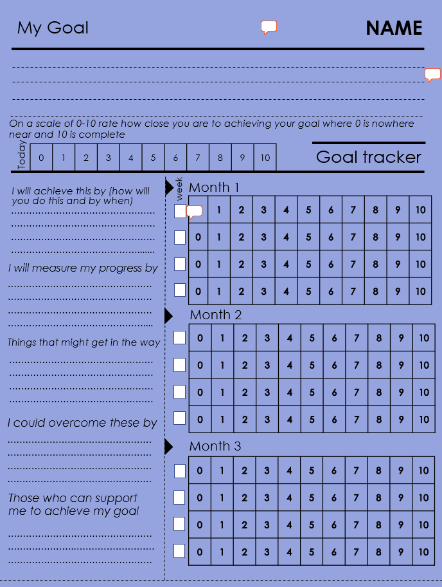
Essentially over the course of the programme you will be working alongside the young person towards goals that are meaningful to them.
During the time spent with the young person it is hoped that you will weave in some of the CBT tools and techniques.
Your supervisor will support your thinking about matching tools and techniques to young person’s presenting need.

Slide 39

The “Your Choice” approach to CBT.
Your Choice had a small impact on reducing self-reported severe conduct problems amongst children.
​
​Your Choice had a moderate impact on improving children’s self-reported:
​Emotional self-regulation
Social connectedness
How safe they felt.
Practitioners, however, perceived children to be less safe, likely a result of increased knowledge through increased contact
Notes:
The YC is evidence led- just to recap on the findings from the RCT

Slide 40
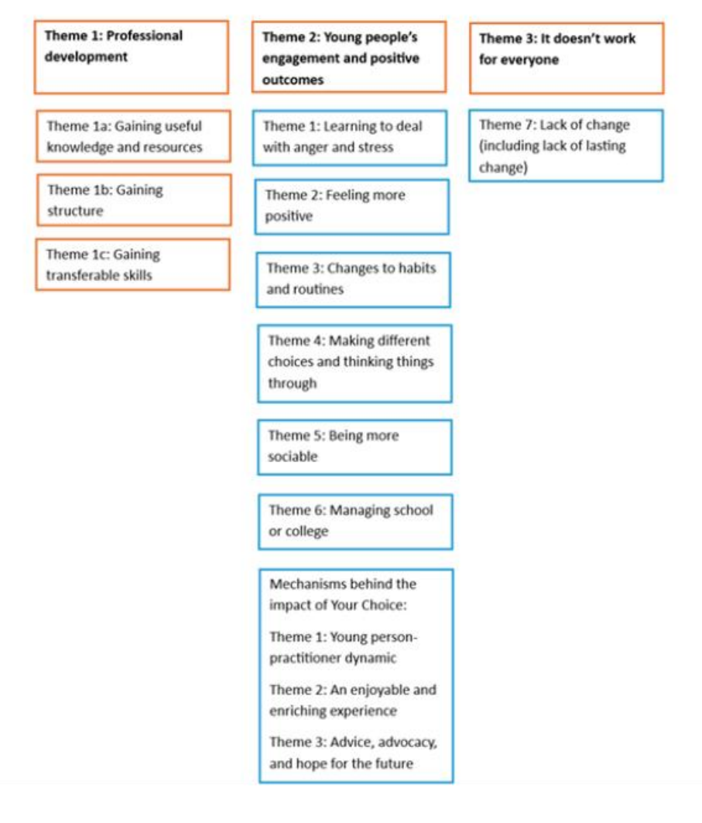
The “Your Choice” approach to CBT.
Notes:
“Seeing the children who have really benefitted, you know, it’s kind of like good news stories, you know, that kind of spreads. And it gives people hope, excitement, a sense of achievement”.
There's a lot I can take from it, like the motivation. There was ways to motivate yourself and everything. So, there's a lot I can take back and use them in my everyday life”
Young person

Slide 41
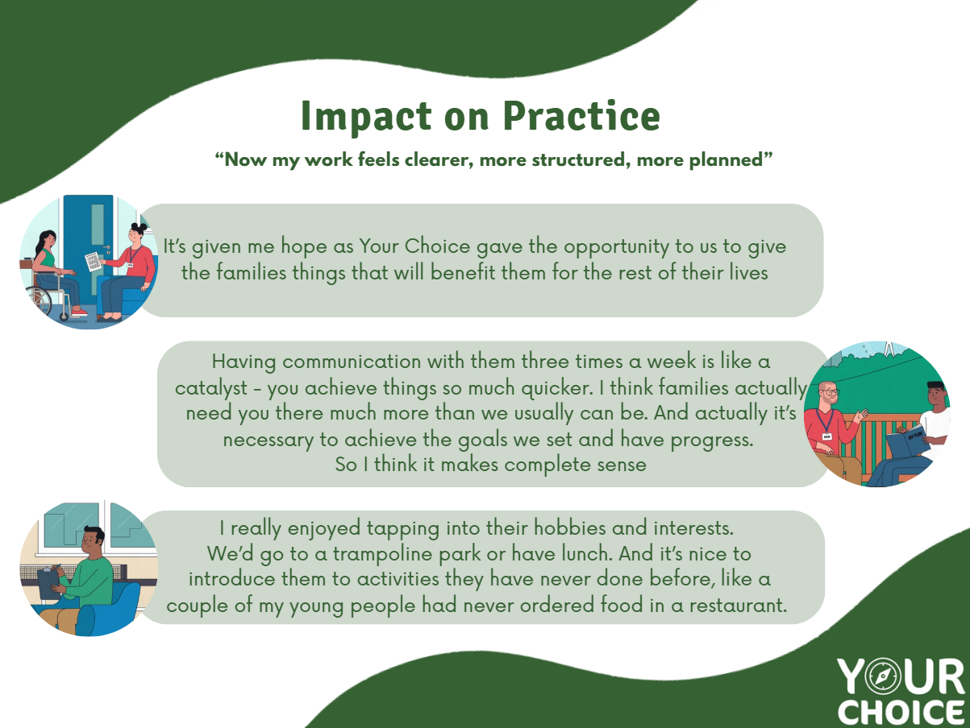
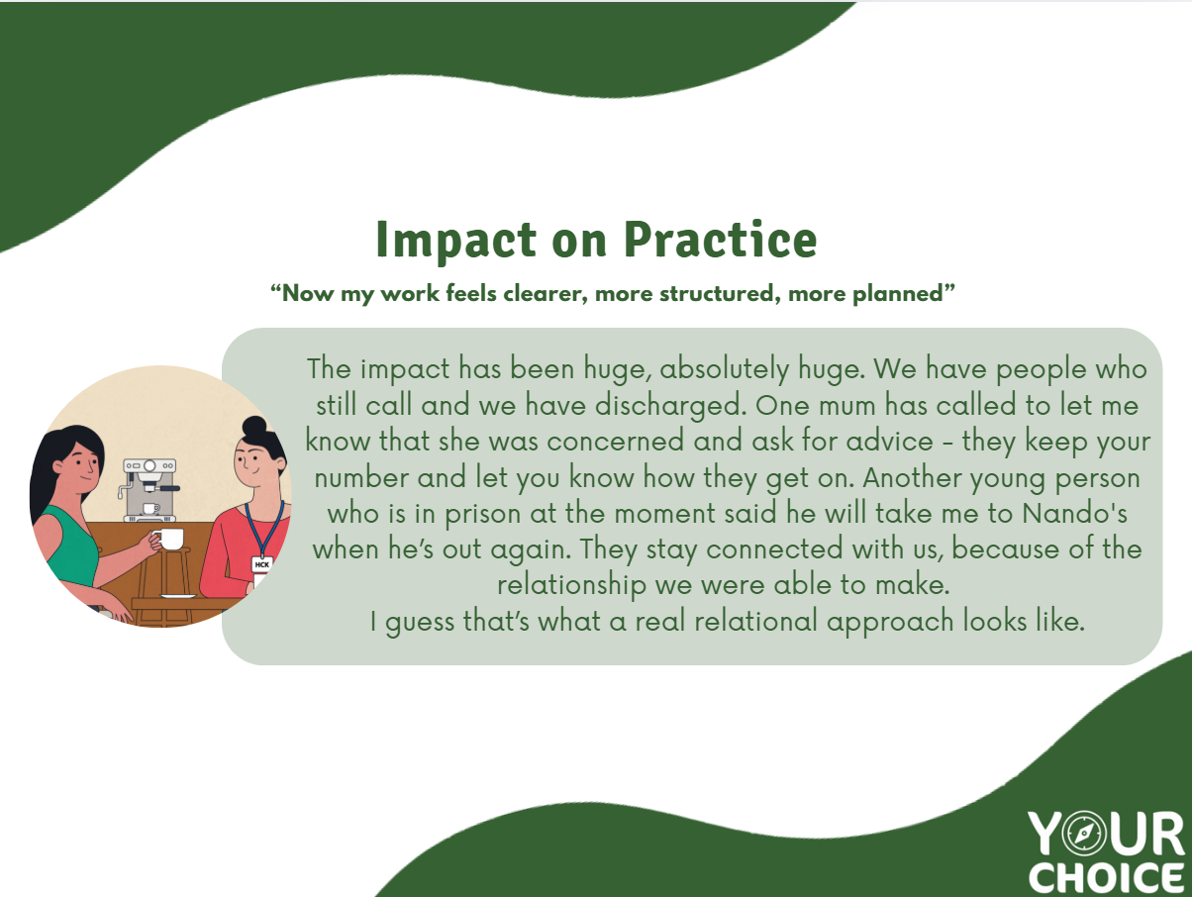
Your Choice- What practitioners say…

Slide 42
Your Choice- What young people say…
Your Choice saved my life. If it wasn’t for my Your Choice coach supporting me into my boxing club I would be either dead or in prison.
Young person
Notes:
Other quotes include “Sometimes, when I feel my chest getting tight, I be using those breathing exercises. And it just all releases it at once. It just gives you a massive relief. Do you get me? And you just feel better and just feel a bit more free”
If you know how each other feels, then you don’t really argue about it because you understand how people are feeling”

Slide 43
Guiding principles
1. Invest in relationships. They matter a lot….before, during and after your involvement
Sadly, the young people we work are likely to have experienced relational trauma, which can impact on their ability to identify with and build trusting relationships. Yet young people will need a safe base, a trusted adult alongside them in order to explore new thinking, feelings and behaviours.
It takes time, courage, care and a whole lot of patience to get to know young people, for them to get to know who they are working with and the relationship between you. They will benefit from trusted others who get alongside them as they start to explore different parts of themselves, ways of being and new behaviours.
Young people will need responsive, reliable adults who take time and care to understand them, their needs and wants and wishes. Young people are likely to benefit from your support to identify trusted people in their lives who can continue to model this after completion of the programme.
Notes:
Wherever and however you are delivering Your Choice, there a set of core guiding principles that anchor you in your
Your Choice adopts a relational approach because we know how important relationships are in our work with this cohort.
You could always do this as a sorting task- giving the guiding principle and then the asking trainees to match the text to the principle they think this relates to.

Slide 44
2. Put your oxygen mask on first
In order to help others we need a reflective, skilled workforce who are supported and enabled to prioritise their own wellbeing in order to undertake their role effectively and safely.
Notes:
The nature of our work means that we are often exposed to vicarious trauma. This is why clinical supervision is seen to be so important and embedded as part of delivery of the programme.

Slide 45
3. Model cultural humility and be explicit about culture.
Young people and their families need services to be aware of and overcome cultural barriers to access support. Your Choice is committed to nurturing a culturally curious workforce who are explicit and prioritise understanding and addressing the influence of their own culture, and that of the families and young people that they work with. The Your Choice programme will be uniquely adapted for each young person according to their individual needs and aspirations, which includes cultural influences. The importance of a young person’s culture (which may include youth culture) should be reflected in the approach and delivery of the programme.
Notes:
Cultural humility amongst the workforce is important to overcome cultural barriers.

Slide 46
4. Prepare for the end at the beginning.
The relational approach of the programme provides an opportunity to model safe, appropriate relationships. Being clear from the outset about endings will allow young people and their coaches to prepare and experience an appropriate ending of a relationship that acknowledges the difficult feelings that this may trigger for those young people who have otherwise experienced neglectful, harmful, rejection.
Identifying and involving safe, appropriate people in a young person’s life and including them as part of the programme will support and encourage young people to stay focussed on their goals and aspirations beyond the programme.
Notes:
We can’t go on forever, we need to be prepared to help young people and their families to find ways in which they can continue with their gaols and aspirations after the programme.

Slide 47
5. Take an optimistic stance to the age of opportunity
Adolescence is a critical, unique developmental phase where, with the right support the malleable adolescent brain and development of identity provides as much opportunity as it does risk. Neural pathways are either re-enforced or pruned away- every contact leaves a trace. Therefore increasing opportunities to connect with young people increases opportunities re-enforcing positive, pro social neurological and behavioural pathways and reachable, teachable moments with well intentioned, skilled adults and or mentors.
Hopelessness can be life threatening. Search for, spread or inspire hope wherever you go. To start with this might be more easily found externally (i.e. in a role model) but as you work your professional magic and your young person gets to know themselves differently and enable new opportunities this should become more readily available to the young person.
Notes:
We know that young people get a bad press but we need to take an optimistic stance to the age of opportunity.

Slide 48
6. Adopt a young person centred approach to enable Access-ability
The psychological tools and techniques to enhance safety and wellbeing should be accessible for those most in need. We need to be creative, flexible, adaptable in order to meet the young person where they feel safe (both physically and psychologically) to enable them to access support.
Each Your Choice programme will look different for every young person but will always focus on a building and nurturing a young person’s strengths. Young people will be empowered to become active agents in their lives whilst recognising the wider responsibilities of others to keep them safe. The Your Choice tools and techniques will be adapted for each young person according to their individual needs, including their individual circumstances, learning, educational and developmental needs and motivation to engage and change.
Notes:
Your Choice is all about enabling access, therefore we need to adopt a young person centred approach.

Slide 49
7. Nothing for me without me (YPAG).
Young people, their families & communities are the experts in their own lives and should be supported and empowered to understand and engage in value-based behaviours in order to find and fulfil their purpose and potential.
Similarly, LAs know the families they serve, communities and local landscape and will bring their local expertise to support development, delivery and impact of the programme.
Active and meaningful participation and collaboration with stakeholders including young people, their families, their communities and Local Authorities is central to programme development.
Notes:
Really important and so well put by our friends and young people at the VRU’s YPAG. Nothing for me without me.

Slide 50
8. Activate and embrace helpful networks.
No single intervention is likely to resolve the complex issue of youth violence and contextual safeguarding and no one individual is responsible for holding risk. It takes a village. Wherever possible Your Choice should be included as part of a wider plan for intervention involving important people in the young person’s life, the professional network and a wrap around, shared multi-agency response to concerns around contextual safeguarding.
Connecting young people with safe, local communities will provide accessible, sustainable support for families. An important part of the Your Choice programme is supporting young people to identify with and access different, safe communities, which will support and nurture them long after the completion of the programme.
Notes:
We are dealing with complex issues and complex lives. No single intervention or single worker is likely to resolve these and it is important that our staff are aware and supported to understand that no one individual is responsible for holding risk. So we need to try and activate and embrace helpful and safe networks.

Slide 51
9. An evidence base is only as good as it’s evidence base.
Currently those disproportionately affected by serious youth violence are disproportionately under- represented in the evidence base. Promoting a more representative evidence base is an important part of understanding and addressing disproportionality and anti-racist practice.
Notes:
And finally, we are all part of something exciting….and really important. Our involvement in the LYPS means that we are making really important contributions to promoting a more representative evidence base, which is a really important part of understanding and addressing disproportionality and anti racist practice.

Slide 52
A Your Choice Case Study
Notes:
Opportunity to introduce a young person that you think would/ has benefitted from the programme. You will refer to this case throughout the training to help trainees think about how to apply to what they are learning in their practice.
Ideally you will invite one of your current coaches to talk about one of their Your Choice cases. Otherwise you may consider inviting your Clinical Lead to present a case. Would be helpful to share following information;
If talking about a Your Choice graduate the would be helpful to provide the following; Background Information, engagement with Your Choice, identifying the hook, examples of where CBT tools and techniques have been weaved in. If you have a coach then some reflections on clinical supervision might also be useful to share.
Otherwise Ask coaches to try and picture a young person that they are working with (or if they can’t someone that they have worked with in the past) who they think would be eligible for Your Choice and ask them to hold them in mind as you progress through the remainder of the training. Some suggested prompts:
What do you know about the young person’s rhythm that would help you plan your sessions?
Who in the young person’s network would support them to work towards their goals?
What does the young person need to be able to build in time to practice new ways of being?
How will Your Choice integrate with other intervention?
The training also provides an opportunity for Your Choice coaches to understand themselves better so delegates will be encouraged to engage in some self reflection exercises throughout the training.

Slide 53

Young person: Jo
Aged: 17
History: Previously known to social care in relation to early trauma
Current involvement: Open to YOS for possession of offensive weapon.
Concerns around contextual safeguarding and possible gang affiliation.
Recent significant trauma- friend murdered.
Relying on substances to manage difficult feelings.
Historic non engagement with services.
Your Choice: Excited to take part in the programme. Has spent time getting to know Your Choice coach, exploring his values and figuring out what interests him. He has shown an interest in playing football.
Your Choice Programme: Jo is working towards a goal to join a local football team. He hasn’t spent much time with a football recently and wants to feel more comfortable before playing with others. Jo meets with his coach twice a week and Jo has given permission for his coach to feed back progress to his parents once per week. During their sessions together, Jo and his coach practice some drills together in the local park. Jo and his coach begin each session with some breathing and mindful exercises to start the session right, to get “into the zone” and ends with progressive muscle relaxation as part of the warm down. Jo is encouraged to use these techniques regularly at home and at school. They are currently exploring local teams that they will look to approach in the coming weeks and talking through some of Jo’s nervousness about joining a new team.
Notes:
If you are unable to include current Your Choice coach or clinical supervisor then you could present the case study referred to later in the programme to provide an introduction of what the programme looks like in practice.

Slide 54

C B T

Slide 55
Therapeutic skills
Refers to the relationship components of the intervention “The horse that comes before the carriage”.
Relationships that are safe, collaborative and trusting are likely to impact on engagement and outcomes (Thomson et al, 2007).
Young people will need to feel safe in order to try out new behaviours.
Notes:
So starting with the T, in CBT the T stands for Therapy. "Your Choice" is not therapy but it does adopt a therapeutic, relational approach, therefore it is important to take a look at or revisit some important therapeutic skills. This refers to…..

Slide 56
The young people who are engaged through Your Choice are likely to have experienced relational trauma. This can lead to people feeling threatened, fearful and unsafe in other relationships. This might be particularly evident when they are developing a new relationship with someone new, including you.
The trauma informed principles of choice, safety, empowerment, trust and collaboration will be important to hold in mind when you are working through the Your Choice programme.

Slide 57

What are your magic ingredients?
You have been selected to be a part of "Your Choice" as you have the skills and abilities to engage with the LYPS cohort.
What magic ingredients do you bring that enable young people to work with you?
Notes:
The exercise- In groups-
What makes them hard to engage?
What’s the magic ingredients? What do they bring to their work that helps with engagement?
Is there anything about the programme that may compromise this?
NOTE FOR TRAINER. This groups exercise is designed to get coaches thinking about those therapeutic/ relational skills that they bring to their work and to highlight these as important aspects of the Your Choice approach.

Slide 58
  How might young person’s experiences impact on how they present and/or engage with the programme?
  How would this impact on how you approach your work with young person?
Notes:
Case study group or paired discussion
Suggested Prompts:
Is there anything to consider at allocation stage?
Would a phased approach to engagement be helpful?
How could you involve the existing network?
What do you need to know about existing risk and safety plans?
How could you make use of supervision to support approach?

Slide 59

Top Tips for building and maintaining relationships
Promote Choice and collaboration
As professionals, we often have more power than the young people that we work with because we represent the systems that we work with but recognising that young people and their families are experts in their own lives is important. As professionals it is our role to bring our professional skills, experience and knowledge to help problem solve and work in partnership to; help overcome difficulties, define goals and plan together.
Offer flexibility & be responsive
We know that offering flexibility can be difficult in the context of your roles. However, in working collaboratively it is important to offer young people choice and flexibility where possible. Ensure to tailor interventions to individual characteristics and special needs including cultural background, spiritual beliefs, gender identity, sexual orientation.
Show an interest in the young person's interests
A key principle of the Your Choice Programme is meeting young people where they feel safe. Showing an interest in their interests, and engaging with them through these interests, provides an opportunity for you to get to know the young person while demonstrating to them that you care about the things that are important to them.
Be transparent
Transparency is really important in developing and maintaining a trusting relationship. While you won't always be able to tell young people what they want to hear, transparency around your work, the principles of confidentiality and the possibilities and potential outcomes will support the development of a trusting relationship and help young people to make informed choices, even when things aren't going as hoped.
Do what you are say you are going to do
This is essential in developing and maintaining trust within relationships with young people. It helps them to see that you are a reliable person that they can depend on to show up for them in the ways that you have agreed between you.
Actively listen
Active listening, through gestures and body language, helps to build trust as it communicates to the young people that you are listening to understand them and their experiences, rather than listening to respond. It also provides opportunities for you to show empathy and allows the young person to feel heard and validated which are core components of relationships that feel safe and containing.

Slide 60
Stay alert to feedback.
Pay attention to spoken and unspoken feedback. Capturing data to spot and address any adverse effects/ deterioration in presentation can prevent drop out. This can also help to recognise and re-enforce success to maintain motivation.
Be ready to handle negative emotions.
This can become difficult to manage repeatedly and requires practitioners to remain alert to their own reactions & responses to challenging presentations and make use of supervision in order to support your resilience.
Be prepared to repair ruptures.
Many factors can impact on the relationship such as a misinterpretation of something that has been said or feelings of mistrust
  Confrontation ruptures- when there are external expressions of anger
  Withdrawal ruptures- when an individual pulls away from the intervention or their plan
  Stay alert to quieter indications and remain open to working through ruptures with the support of your supervisor.
Plan for the end at the beginning and promote effective endings.
1) Acknowledge when the end is in sight
2) Have a mutual discussion about how things went
3) Discuss the young person’s future functioning and coping,
4) Help the young person use new skills beyond the programme,
5) Frame personal development as an ongoing process,
6) Anticipate post-programme growth,
7) Talk specifically about what it means to end this programme,
8) Reflect on young person’s gains,
9) Express pride in the young person’s progress and in the mutual relationship.
(Norcross, 2017)
Use supervision
Working with young people who have had difficult experiences can evoke strong feelings in us as professionals. Supervision is a great space to receive support while reflecting on and unpicking our experiences of engaging and building relationships with young people, in particular individual factors that may be impacting on your ability to relate and be relatable to each other.

Slide 61
Cultural competence/sensitivity
What is culture?
Notes:
A particular zoom in on culture as cultural competence was highlighted as the biggest factor in the barriers to engagement and access to clinical intervention in the power the fight report. So through the Your Choice programme we need to ensure that we remain culturally sensitive in our approach and in our day to day.
Group discussion. What do we mean by culture & why do we think it is such a big barrier. Points for discussion might include issues of stigma, jumping to conclusions, lack of awareness, discomfort (in ourselves as practitioners perhaps)

Slide 62
Cultural competence/ sensitivity
Culture defines an individuals’ specific “ways of being” that are shaped by the intersection of their identity and their lived experiences.
Culture goes beyond physical identifiers and can include sexual orientation, religion, socio-economic status, language. It influences our behaviours and impacts our lifestyle choices.
It is important not only to be aware of young person’s culture but also your own and how this may impact on the relationship. Supervision sessions will provide an opportunity to explore this.
Remember young people are the experts in who they are and their life experiences. It is important to consider the role of culture in your formulation.
Individuals are more likely to feel heard and understood, enabling a safe space for young people to express themselves when appropriate consideration is given to their backgrounds and experiences.
Notes:
The terms cultural sensitivity is the preferred phrase as the term competence suggest that there is an end state whereas culturally sensitivity encourages us to stay alert and humble to an individual’s individual experiences.
Culture defines an individual’s specific way of being….

Slide 63
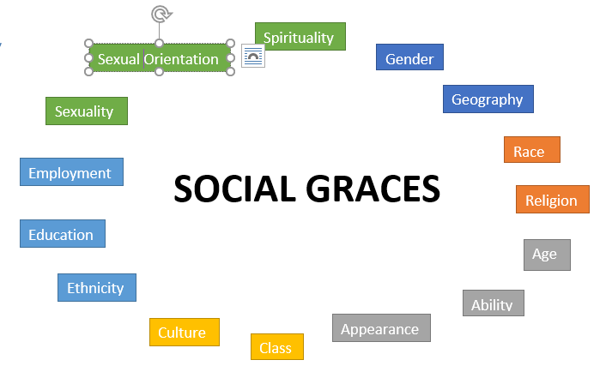
How has your view of yourself been influenced by the social GRACES?
How have these contributed to any strengths and areas of resilience that you have?
How might the social GRACES influence on your work with young people?
Notes:
This exercise provides an opportunity to introduce the visible and invisible influences that may impact on the relationship between young person and their coach
Many will be familiar with social graces but this next exercise provides an opportunity to reflect on practitioners own social graces. For those who would feel uncomfortable engaging in this task on a personal level the questions could be adapted to consider another person- either in their life, or someone that they are working with or the case study Jo.
During supervision coaches will be encouraged to consider how GRACES may be influencing their relationship or responses to young people on Your Choice.

Slide 64

Joe
Adeola
Taylor
Notes:
The resource pack includes a number of characters with different GRACES with suggestions for how tools can be adapted accordingly.
Introducing Joe, Adeola and Taylor.
Joe is a young man who is happy to chat as you go, he’s happy to chat together but is also happy to write things down. He uses his notes screen on his phone lots.
Adeola is a concrete thinker so struggles with abstract concepts. She needs to be able to visualise to understand things. She struggles to understand and manage her feelings. Young people who are autistic would benefit from adaptations recommended for Adeola.
Taylor struggles to concentrate for long periods and so finds it easiest to engage with activities that are creative, involve movement. Taylor prefers shorter, more frequent sessions to ensure that they can concentrate. Young people with ADHD would benefit from adaptations recommended for Taylor.

Slide 65
Starting the conversation about culture with young people
1. What aspects of your culture are important to you?
2. What are some cultural experiences that have shaped your life?
3. How has your background, the way you identify yourself, or cultural experiences impacted on you?
4. Is there anything about your culture that is important for me to know in order for us to work well together?
Notes:
Some suggested ways for starting the conversation about culture with young people. Encourage group to reflect on their own experiences tips for starting the conversation.

Slide 66
https://youtu.be/BEVc-YtrSoA
Notes:
A powerful video from Young Minds about the importance of staying curious

Slide 67
  What aspects of the young person’s culture are important to them?
  How would you develop your own understanding of young person’s culture to support you in your work with them?
  What aspects of your own culture are important to acknowledge to help you to work well with the young person?
Notes:
You could map out iceberg
How would you find this out?
How would you develop your own understanding of young person’s culture to support you in your work with them?
How would you check in with young person to understand what this means to them?
What aspects of your own culture are important to acknowledge to help you to work well with the young person?
How would explore this? How would you explore this with young person?

Slide 68
C B T
The 5 factor
model

Slide 69


Introducing The Five Factors CBT Model
Situation/ Environment
Thoughts
Behaviour
Emotion
Bodily sensations sensation
Padesky (1990)
Notes:
An introduction to principles of CBT and the 5 factor CBT model.
The 5 factor model in CBT neatly demonstrates the connections between situation, thoughts, emotions, bodily sensations and behaviours in the context of internal or external triggers (the situation/ environment). These 5 factors are considered to be so closely connected that changes in any one of these can lead to changes in the other factors.
This 5 factor model allows you to develop a here and now formulation with young person to develop a mutual understanding about the causes, precipitants and maintaining influences of a person’s problems’ (Eels, 1997).

Slide 70
Traditional CBT targets thinking and behaviour
Situation/ Environment
Thoughts
Behaviour
Emotion
Bodily sensations sensation
Padesky (1990)
Notes:
In CBT we target thinking and behaviour as it is thought that we can influence these and have more control over those parts of the system. If you change one part of the process then this will provoke changes in other areas.

Slide 71
The Five Factors CBT Model
Situation/ Environment
Thoughts
Behaviour
Emotion
Bodily sensation
Padesky (1990)
Notes:
We are suggesting that the starting point for those on the Your Choice programme is to look at shifting the behaviour, by identifying and activating their hook (based on their interests) and going and doing with the young person in accordance with this, to positively impact on the chain of events.

Slide 72
A vicious cycle
Thoughts
Situation/ Environment
Arrested
Behaviour
Emotion
Bodily sensation
Padesky (1990)
Notes:
Let’s take an example to work through to highlight how a shift in behaviour can break a vicious cycle. You are working with a young person who is arrested….
(You are free to use a different example that fits with context of trainees caseloads- please use the following slide instead where the situation is left blank for you to input a different example).

Slide 73
A vicious cycle
Thoughts
Situation/ Environment
Behaviour
Emotion
Bodily sensation
Padesky (1990)
Notes:
USE THIS SLIDE IF YOU WISH TO USE YOUR OWN EXAMPLE

Slide 74
A vicious cycle
Arrested
I’m going to prison
Skip school and spend time with “elders”
Scared, angry, hopeless
Raised heart rate, clenched fists
Padesky (1990)
Notes:
They tell themselves that they are going to prison, which leaves them feeling scared, angry and hopeless, raising their heart rate and all those fight or flight responses, putting them on high alert. Game over in their head so they skip school and spend more time with their elders- likely leading to more trouble thereby re-enforcing the cycle.

Slide 75
Breaking a vicious cycle using Behavioural Activation
Arrested
I’m going to prison
Skip school and spend time with “elders”
Scared, angry, hopeless
Raised heart rate, clenched fists
Padesky (1990)
Notes:
So let’s start with tackling the behaviour in the first instance and see how this can change things.

Slide 76
Breaking a vicious cycle using Behavioural Activation
Arrested
Visit and train at boxing gym
Padesky (1990)
Notes:
Instead of skipping school and spending more time with their elders. Let’s say the young person is encouraged to attend and train at their local boxing gym

Slide 77
Breaking a vicious cycle using Behavioural Activation
Arrested
Visit and train at boxing gym
Empowered, inspired, accepted
Padesky (1990)
Notes:
This could lead to them feeling empowered, inspired and accepted (as well as increasing exposure to positive influence).

Slide 78
Breaking a vicious cycle using Behavioural Activation
Arrested
Visit and train at boxing gym
Empowered, inspired, accepted
Reduced tension, improved energy levels
Padesky (1990)
Notes:
This leads to reduced tension in their body and improved energy levels.

Slide 79
Breaking a vicious cycle using Behavioural Activation
Arrested
Training keeps me motivated and away from more trouble
Visit and train at boxing gym
Empowered, inspired, accepted
Reduced tension, improved energy levels
Padesky (1990)
Notes:
In their heads they think “training keeps me motivated and away from more trouble”.

Slide 80


Breaking a vicious cycle using Behavioural Activation
Arrested
Training keeps me motivated and away from more trouble
Visit and train at boxing gym
Empowered, inspired, accepted
Reduced tension, improved energy levels
Padesky (1990)
Notes:
You can see how each part of the cycle can positively influence each other.

Slide 81
Six Senses Self Soothe
Vision.
Go to your favourite place, take in all the sights, look at some photos.
Hearing.
Listen to your favourite music, put it on repeat, create a playlist of your favourite tunes, sing, rap.
Smell.
Put on your favourite fragrance, use a scented shower gel or aftershave.
Taste.
Eat some of your favourite food or non-alcoholic drink (do it mindfully and in moderation. Don’t overdo it!)
Touch.
Take a long hot bath or shower, pet your cat or dog, brush your hair, hug someone, put a cold cloth on your head, change into your favourite clothes.
Movement.
Go for a run, stretch, dance, go to the gym.
Notes:
End the day by asking your coaches to think through some self soothing activities that they enjoy- encourage them to share ideas amongst the group and then commit to one of the self soothing/ relaxation exercises this evening. They can later encourage their young people to try out various exercises. Receptive young people may want to put together a six sense or self soothe box where they can collate objects// reminders in one place. Once you’ve identified meaningful self soothing activities, objects or imagery you can encourage young people to use these as grounding techniques regularly to help maintain a sense of wellness but also when they are heightened, distressed.

Slide 82

End of Day 1
Notes:
Arrived at end of day.
Check out with trainees.
What are their key take home’s from today’s session.
What has worked well in supporting your learning?
What would help to support your learning needs in Day 2?
What are they looking forward to on Day 2?

