Slide 1

Day 3
Notes:
Check In
Reflections/ questions from yesterday
How will you (trainer) respond to feedback from yesterday’s session.

Slide 2

Learning objectives Day Three
To understand the role of thoughts on behaviour and strategies for responding to these.
To introduce case formulation and the importance of supervision to support these.
To support preparations for Day Four of the training programme.
Notes:
Arrived at end of day.
Check out with trainees.
What are their key take home’s from today’s session.
What has worked well in supporting your learning?
What would help to support your learning needs in Day 3?
What are they looking forward to on Day 3?

Slide 3


Progressive muscle relaxation
  Squeeze both hands as if you are squeezing a lemon & get all of the juice out of them. Hold for count of 5.
  Stretch forward like a cat and or up to the sky as high as you can go. Hold for count of 5.
  Imagine someone has put an i.e. cube down your back and you are trying to get it out. Pull your shoulders together as close together as you can. Hold for count of 5.
  Point your toes as hard as you can, like a ballerina or pushing your big toe into sand. Now pull your toes up through the sand, up towards the sky. Try to get your big toe to your shin. Hold for count of 5.
  Tighten your stomach as though someone is going to drop a ball on it. Hold for count of 5.
  Imagine there is a fly on your nose. Scrunch your nose to try and get it off. Then imagine it was moved to your forehead, tighten your face to try and get rid of it, or pull a surprised face, raise your eyebrows and open your mouth. Hold for count of 5.
Notes:
Arrived at end of day.
Check out with trainees.
What are their key take home’s from today’s session.
What has worked well in supporting your learning?
What would help to support your learning needs in Day 3?
What are they looking forward to on Day 3?

Slide 4

C B T

Slide 5


Traditional CBT targets thinking and behaviour
Situation/ Environment
Thoughts
Behaviour
Emotion
Bodily sensation
Padesky (1990)
Notes:
Now, turning our focus to the “C”- the cognitive part. Recap on the 5 factor CBT model- by targeting thoughts we can affect change in other parts of the system.
Thoughts- refer to the thinking that occurs in our heads and can include memories, thoughts about the future and the past, dreams etc.

Slide 6
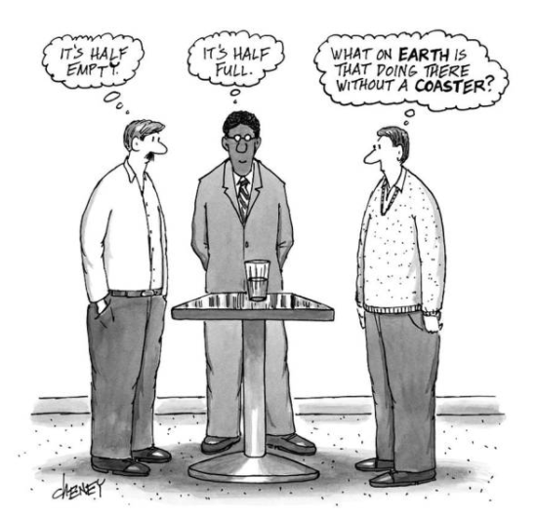
What CBT is not!
Notes:
Contrary to popular belief, CBT is not about getting people to think more positively.

Slide 7
Interpretation is key in CBT
Actual or activating event emotional and behavioural response
Actual or activating event Beliefs & meanings about event
In CBT, it is not the event in itself that is considered to be the trigger for behaviour but rather an individual’s interpretation of the event.
Emotional & behavioural response
Notes:
Instead, one of the key principles underpinning CBT is that it is not the event in itself that elicits a responding behaviour but rather the interpretation of events and that is the target for the Cognitive part of the intervention.

Slide 8

Scenario
You are meeting a friend for lunch at 12p.m. It is 12.30 p.m., and your friend still hasn’t arrived…
Notes:
So let’s work through an example together of how an event can trigger a whole host of responses based on how we interpret it.
You can use this example or feel free to engage your audience to identify a situation which may trigger a series of events.

Slide 9
What might you be thinking?

Slide 10

She must have been involved in an accident. She didn’t want to spend time with me anyway and this just proves it. She is so unreliable and rude to have left me waiting She must be stuck in traffic.

Slide 11
Scenario
Situation
The event has triggered a series of automatic thoughts
Thoughts
Notes:
Any given event can lead to a variety of interpretations but we will not always evaluate the situation correctly.
Our interpretations tend to stem from automatic thoughts that pop in to the mind rather than deliberate thinking.
We don’t always notice our automatic thought but are perhaps more likely to be aware of the feelings that they evoke.

Slide 12
Situation
Thoughts
How might this impact on how you feel?
Emotion

Slide 13
Thoughts | Emotions
She must have been involved in an accident. | Anxiety
She didn’t want to spend time with me anyway, nobody does. | Sadness
She is so unreliable and rude to have left me waiting | Angry
She must be stuck in traffic. | Unaffected
Emotions

Slide 14

How would this impact on bodily sensations?
Situation
Thoughts
Emotion
Bodily sensation

Slide 15
Bodily sensations
Thoughts | Emotions | Bodily sensation
She must have been involved in an accident. | Anxiety | Raised heart rate, shortness of breath, feelings of butterflies
She didn’t want to spend time with me anyway, nobody does. | Sadness | Tired and heavy
She is so unreliable and rude to have left me waiting | Angry | Tense muscles, rapid heart rate
She must be stuck in traffic. | Unaffected | Not noticeable

Slide 16
Situation
How would this impact on behaviour?
Thoughts
Behaviour
Emotion
Bodily sensation

Slide 17
Behaviour
Thoughts | Emotions | Bodily sensation | Behaviour
She must have been involved in an accident. | Anxiety | Raised heart rate, shortness of breath, feelings of butterflies | Try to call friend or local hospitals.
She didn’t want to spend time with me anyway, nobody does. | Sadness | Tired and heavy | Text your friend and tell them something has come up so you have to leave.
She is so unreliable and rude to have left me waiting | Angry | Tense muscles, rapid heart rate | Leave the restaurant in state of rage and block friends calls.
She must be stuck in traffic. | Unaffected | Not noticeable | Order a drink and use the time to check your emails.
Notes:
This example highlights one of the main principles of CBT- that how we respond to a given situation will start with our interpretation of the event. The degree of emotion felt will be linked to how true the person believes the thought to be true. For example if an individual truly believes that their friend has been involved in an accident then they are likely to feel extremely anxious. The aim of CBT is not to “think positively” rather to realistically evaluate the thought.

Slide 18
Working out what fits where?
Situation/
Environment
Is tearful an emotion or a behaviour?
Is feeling heavy an emotion or bodily sensation?
I feel like he doesn’t like me- an emotion or thought?
Thoughts
Behaviour
Emotion
Bodily sensation
Padesky (1990)
Notes:
It can be tricky to differentiate between the different factors. For example, is tearfulness a behaviour or emotion, does feeling heavy fall under physical or emotional and so on and so forth. In reality it doesn’t really matter but it is important to hear what the young person understands it to fall under.
However it is important to distinguish between thoughts and emotions- for example I feel like he doesn’t like me is a thought (unless this has been clearly stated by the other person) and distinguishing between this and fact is an important part of the intervention.

Slide 19
There are three levels of cognition referred to in CBT.
Your Choice focuses on automatic thoughts.
Automatic thoughts
  Involuntary instantaneous and nonconscious images and thoughts, that occur throughout the day.
Conditional Beliefs
  Rules for living characterised by “if…then” statements”
  e.g. “If I’m nice to people then they will respect me”.
Schemas
  Broad, pervasive themes of oneself, others and the world
  e.g.” I am….Others are…..The world is…”
Notes:
There are 3 levels of cognition referred to in CBT As part of the "Your choice" intervention we will be focussing mainly on automatic thoughts and perhaps some conditional beliefs, to assist young people to have a better understanding of how they process things in their mind.

Slide 20
Automatic Thoughts
Refers to those thoughts that automatically appear in our minds throughout the day.
They are often outside of conscious awareness.
A recent study (Tseng & Poppenk, 2020) suggested we have on average 6,200 thoughts per day.
Thoughts can have an immediate, direct impact on how we feel.
Notes:
Automatic thoughts refer to those instinctive thoughts that appear in our minds throughout the day….

Slide 21
Negative Automatic Thoughts (NAT’s)
Refers to those automatic thoughts that lead to negative emotions.
NAT’s are not always inaccurate but are often biased and subject to error.
In CBT we are not seeking to encourage positive thinking but rather to understand and overcome an individual's thinking traps in order to think more accurately.
Noticing and recording some of these thoughts will help to identify themes and conditional beliefs that you may be able to test out later.
The negative emotion is likely to be more easily identified than the thought, so the key is to identify what comes to mind when an emotion arises.
Notes:
Negative automatic thoughts NAT’s are those automatic thoughts that lead to negative emotions…. Etc.

Slide 22

Common “thinking traps”
Catastrophizing
All or nothing
Fortune telling/ mind reading/
Overgeneralising
Mental filtering
Disqualifying the positive
Personalising
Making demands
Emotional reasoning
Labelling
Notes:
When we are processing information we are likely to fall into some common thinking traps, which give rise to negative thoughts.
For this exercise it is suggested that you prepare a mix and match paper exercise.
(cut categories and text on next slide. Task is to fit them together).

Slide 23
Common “thinking traps”
Predicting a negative disastrous outcome
Sometimes known as all of nothing thinking referring to a tendency to think in absolute or extreme terms discounting the shades of grey that may exist.
Jumping to conclusions, making predictions even though there is no evidence to support this.
Drawing global conclusions from one or more events.
Acknowledging only the information that fits with a belief you hold
Discounting or dismissing the positive experiences, transforming it into a neutral or negative event.
Interpreting event as being related to you personally (OR someone else), ignoring other factors
Inflexible, rigid views or rules about how things “should” or “ought to be”.
Accepting feelings as fact.
Assigning labels to ourselves and others.
Notes:
Note to trainer- To scramble for sorting task

Slide 24
Common thinking trap examples
Your daughter was meant to text me when she arrived safely at her friend's house. I haven’t heard from her. Something awful must have happened.
You’re on a diet and open a bag of Maltesers. You’ve eaten a handful therefore you’ve ruined your diet so you may as well eat the rest of the bag.
Your friend has invited me to go rock climbing. I’m sure it would be fun, but I can get nervous easily, so I’m bound to panic at the top and make a fool of myself and probably end up hurting myself.
Your computer crashes. Nothing ever goes right for me; this always happens to me.
I gave a presentation at work today. It went terribly as most people looked bored (even though you have received positive feedback).
I got offered a promotion at work. I must have been the only one to apply or my boss just felt sorry for me.
I took my little niece to the park, and she fell over and hurt her knee. It was all my fault. I should have been quicker to react and catch her.
I should never let people down so will have to work additional hours this week to make sure all the tasks are complete.
I’m struggling to engage with this young person. I’m terrible at my job.
Notes:
Scramble
Then add the following examples and get them to fit into the categories.

Slide 25
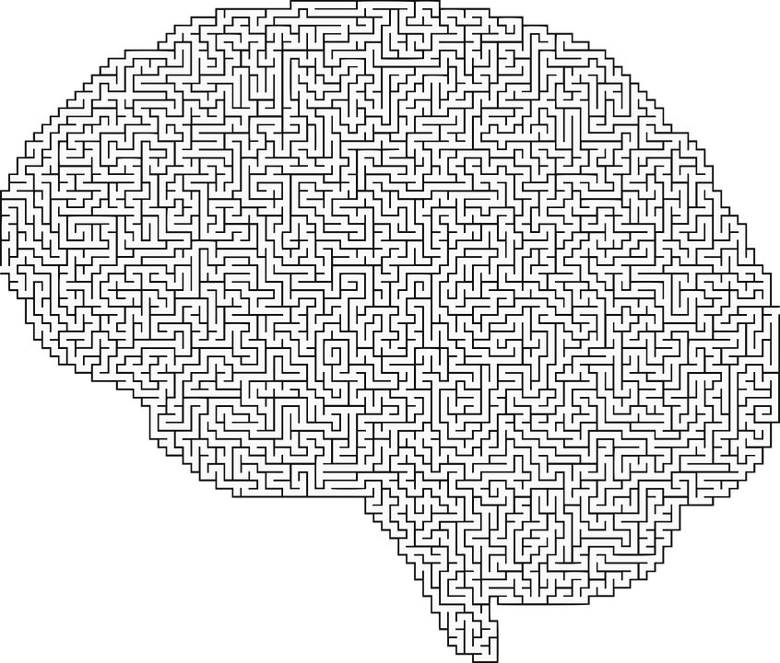
Common thinking traps
What are your common thinking traps?
Notes:
Individual exercise.
Self reflection exercise not expected to share.

Slide 26
Cognitive restructuring & re-framing
A technique referred to in CBT where individuals are supported to discover and challenge their negative and irrational thoughts in order to modify or replace them with more functional thoughts.
Like weight lifting, it requires training and practice to build the cognitive muscles to notice and/ or modify “thinking traps” as they happen.
Draws on different methods to notice and modify thinking patterns
                Thought recording
      Socratic questioning
      De-catastrophising
      Thought challenging
Notes:
So how might you begin to notice the thinking traps that are relevant, what do we do about it?
Cognitive re-structuring and re-framing is a technique referred to….etc

Slide 27
Thought recording
Situation (As much detail as possible about what happened, where, with whom etc) | Feeling (What were you feeling? On a scale of 0-10 how intense was this feeling where 0 is not at all and 10 is strongly felt) | Thought (What thoughts or images were running through your mind. On a scale of 0-10 how much did you believe each one, where 0 is not at all and 10 is totally true)
Notes:
By getting a young person to notice and capture what their thoughts are, how fixed they are in their thinking, what they were feeling and what might have triggered their thoughts, they can begin to notice some of their own thinking traps and triggers.
You could do this exercise like a chain analysis using post it notes to demonstrate what happened and use Lego blocks in one colour to indicate the intensity of feeling (0 for not that strongly felt or 10 for strongly felt) and then use another colour Lego block to indicate how much they believed the thought. It will be important to follow through to what happened, hopefully to demonstrate that the worry thought was heavier than the actual event. Someone like Adeola would benefit from adapting this exercise in this way.

Slide 28
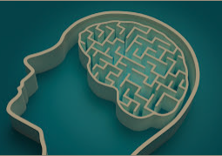
Thought recording
Young people may need your help to recognize their thinking traps.
Consider how you could be creative to capture and identify young person’s thinking traps?
Notes:
Group discussion how you could illustrate these to young people in creative way?
Young people may not be willing to put this onto paper but as situations unfold when you are together with your young person consider how you might begin to capture some of these.
Some suggestions include: put a note in their notes on their phone, send themselves a text, write some lyrics…

Slide 29
Socratic questioning
Originates from Socrates, a Philosopher living in Athens around 400 BC, who spent his time in the marketplace in Athens encouraging young men of Athens to question the truth of popular opinion using questions to help students reach a conclusion without directly instructing them.
Helps foster critical thinking around an individual’s beliefs using probing questions as a way to explore complex ideas, uncover assumptions and challenge cognitive biases/ thinking traps.
Encourages curiosity and teaches an individual to question their own thoughts in a gentle, empathic, guided manner.
Commonly referred to as Socratic Dialogue due to the gentle, curious approach rather than a bombardment of questions.
Notes:
One way to help young people to notice how they are processing is by using a techniques called Socratic questioning.

Slide 30
Socratic Dialogue
Does not seek tell an individual that their thoughts are inaccurate and persuade them to adopt a different point of view.
Rather, it nurtures a collaborative, reflective approach so that an individual can work together with their “guide” to discover new ideas and possibilities.
Requires “guide” to listen with a genuine curiosity rather than assuming that they are telling or guiding an individual to the “correct” answer.
There is no definite list of question but would include a mixture of open ended and more probing questions.
Notes:
The term Socratic dialogue may provide a better description as it is a conversational method rather than a bombardment of questions.
It is an opportunity to draw attention to information that might be outside current focus.
It does not seek to ……

Slide 31
Types of Socratic Dialogue
Clarifying thinking & understanding
Challenging assumptions
Examining evidence and rationale
Considering alternative perspectives
Considering implications & consequences
Meta questions
  What do you mean by that?
  Can you give me an example?
  Why do you say that?
  Is that always the case?
  How could you prove or disprove this assumption?
  What would happen if?
  What evidence is there…?
  Is there reason to doubt this evidence? Would it stand up in Court?
  Is there another way to look at this?
  How would a friend see this?
  Then what would happen?
  What would happen if everyone felt like this?
  Why do you think that’s an important question?
  How does that apply to everyday life?

Slide 32

Thought challenging
Put the thought in the dock
Identify a thought that you want to test out.
Look for evidence to support the accuracy of the thought
What tells you this is true?
What would the defense lawyer say?
Look for evidence against the thought
What tells you this thought is not totally true all of the time?
Is the thought opinion rather than fact?
What would the prosecution lawyer say?
Sum up the evidence
Produce a closing statement based on the evidence that is realistic, rational and balanced.
Notes:
Thought challenging is another exercise helpful in modifying and loosening thoughts. This involves putting the thought in the dock…….

Slide 33
Putting it to the test
On a piece of paper write down a worry thought that you have about getting going with a young person on the "Your Choice" programme. You will be asked to share this so make sure it is something you feel comfortable sharing.
Rate how worried you are on a scale of 0-5 (where 0 is not worried at all and 5 is really worried).
In pairs, decide who will share their worry first. The other coach is on a mission to loosen the worry thought using a series of socratic questions.
Re- rate the worry thought.
Swap over.
Notes:
Some examples might include- “I’m no good at learning new things” or “the young person won’t want to spend all that time with me”. You may include other relevant dilemmas (such as a worry thought about working with a particular family or piece of work) aswell.
Use the slide above to assist and try to include questions from each of the categories (i.e. clarifying thinking and understanding, challenging assumptions etc).

Slide 34

Cognitive diffusion
A willingness to let go of the attachment and over-identification with thoughts that cause suffering.
Allows for the disentanglement from thoughts that cause suffering.
Emphasises that an individual is an observer of their thoughts rather than the thoughts themselves.
Notes:
Cognitive diffusion refers to the process of noticing thoughts rather than getting caught up in them.
It emphasizes a willingness to…
Leaves on a stream exercise from the end of day 2 is an example of an exercise to help create distance between the thought and the person.

Slide 35
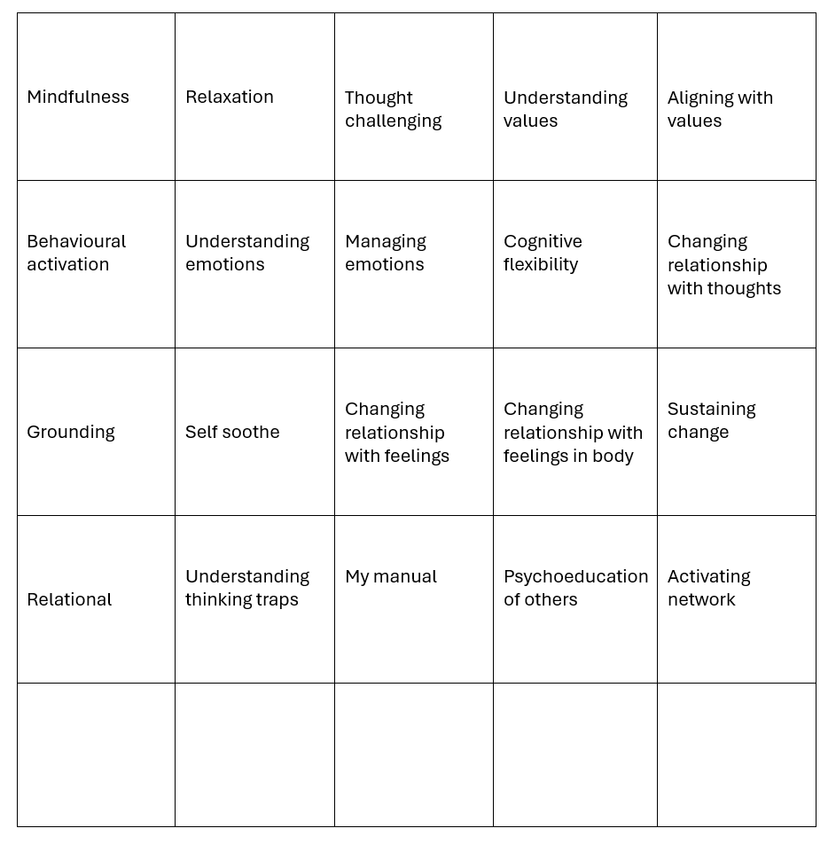
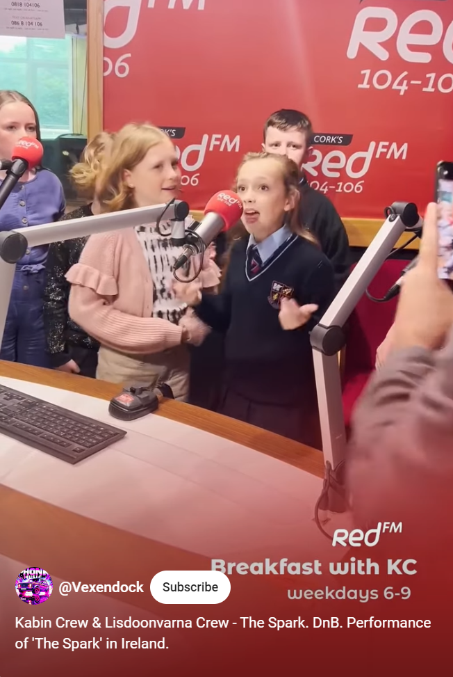
Spot the CBT
  Kabin Crew & Lisdoonvarna Crew - The Spark. DnB. Performance of 'The Spark' in Ireland. (youtube.com)

Slide 36


Case study
Spot the exercises that you could weave into goals and Your Choice activities.
Notes:
Refer back to the case study

Slide 37
Making sense of what’s going on.
Case formulation is the process for understanding an individual’s presentation or problem (or things that are getting in the way of living a meaningful life), when it started and what keeps it going.
This shared understanding (between young person and Your Choice coach in our case) will help to guide intervention and will be a focus during supervision.
Notes:
Practitioners will be supported by their supervisors to bring together what they are noticing to support and guide the intervention. This process of understanding an individual’s presentation is called case formulation.

Slide 38

Case formulation
Case formulation is a collaborative process of developing a hypothesis about the origins, triggers and maintaining factors associated with a person's difficulties, in order to guide intervention.
(Adapted from BPS Good Practice Guidelines on the Use of Psychological Formulation, 2011.)
Notes:
Case formulation slides included here but you may wish to hold a separate session on Case formulation.

Slide 39
Case formulation
Case formulation provides an opportunity for a shared understanding of a person’s difficulties and can offer a way of answering:
What is the problem?
Why this person?
Why now?

Slide 40
What are the benefits of case formulation?

Slide 41
What are the benefits of case formulation?
Clarifies the focus for change by identifying what we are worried about and what we are hoping to change.
Creates a coherent shared narrative that helps young people, families, and professionals understand concerns and possible routes forward
Links past experiences to present difficulties, highlighting how a young person's history may be influencing their current thoughts, feelings, and behaviours
Maintains a clear therapeutic and systemic focus, ensuring interventions remain connected to agreed goals
Promotes curiosity and humility, encouraging tentative and reflective language rather than fixed assumptions.
Supports metacognition, helping young people, families, and professionals think about patterns, meanings, and processes.
Encourages collaborative thinking, bringing together multiple perspectives into a shared understanding.
Recognises the dynamic nature of difficulties, remaining open to new information and evolving hypotheses.
Integrates information from assessments, helping to make sense of findings rather than viewing them in isolation.
Can be therapeutic in its own right, supporting insight, validation, and hope through the development of a shared understanding.
Supports interdisciplinary collaboration by creating a common language and shared understanding across the professional network.

Slide 42
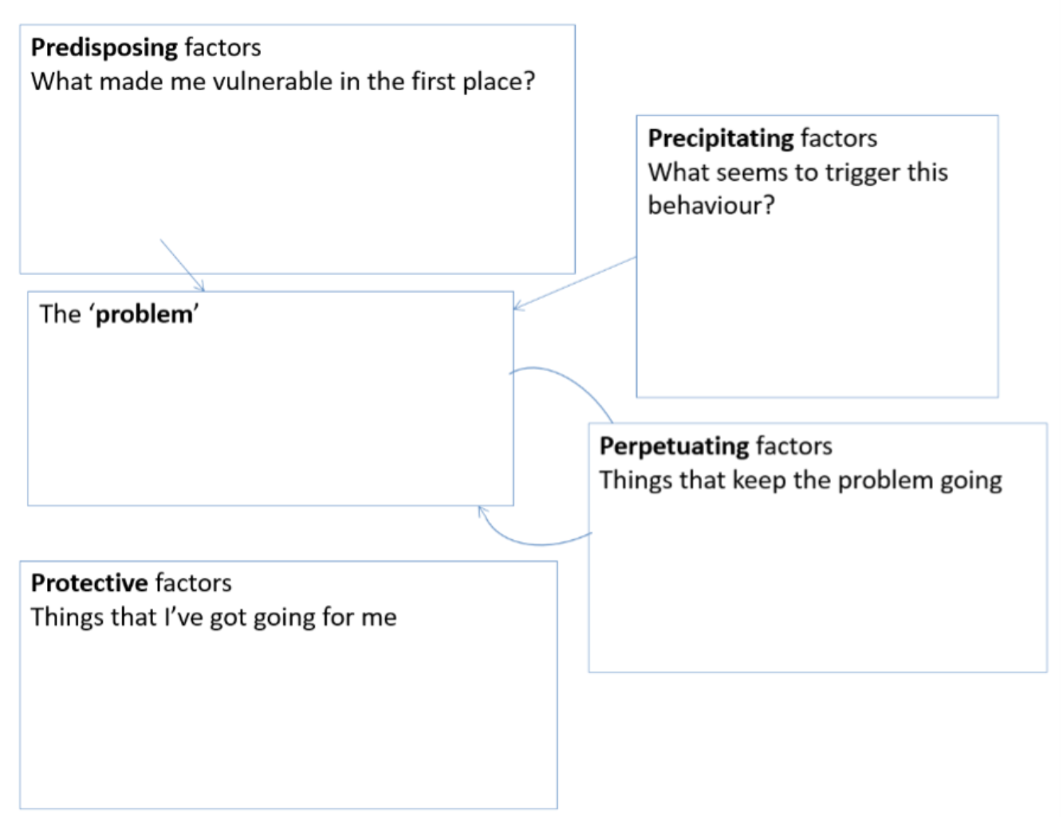
The 5 P’s formulation
Notes:
Introduce the 5 P’s formulation tool

Slide 43
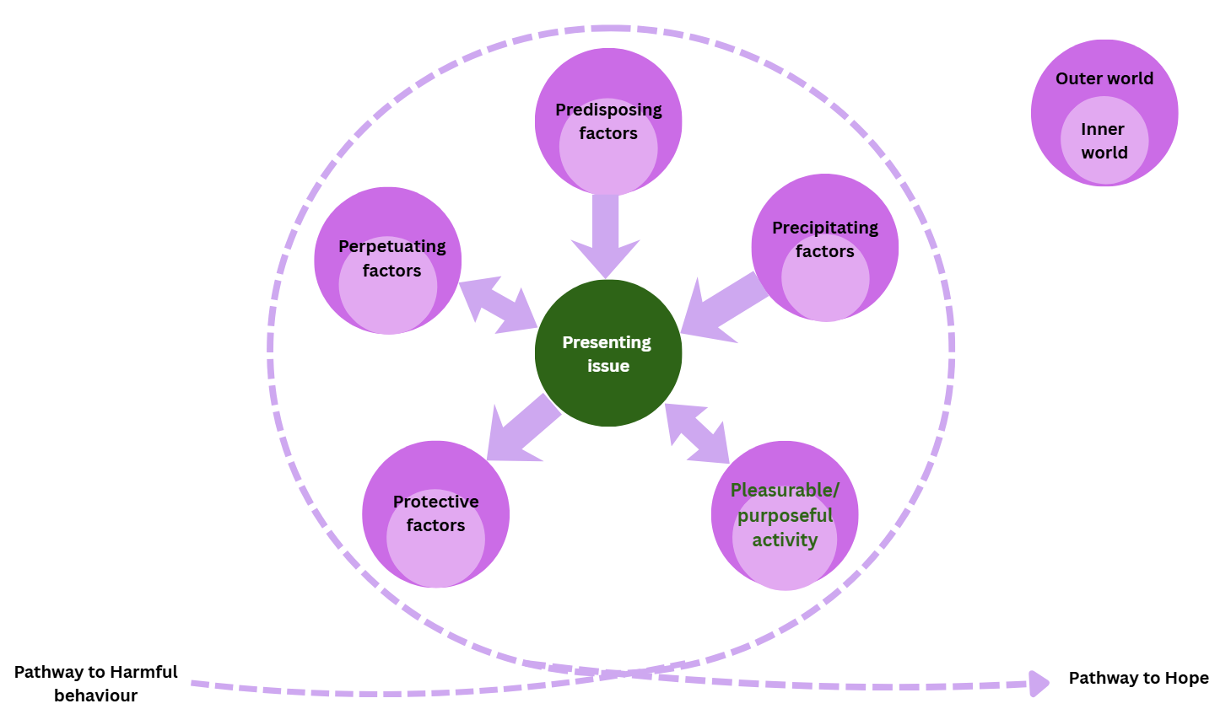
The 7 P’s
Notes:
Introduce the expanded 7 P’s formulation tool that we encourage as part of Your Choice
Note- potential role system can play in perpetuating presenting issue.

Slide 44

The 7 P’s

Slide 45
Pathway to harmful behaviour
Pathway to harmful behaviour
What do we need to prioritise in order to increase safety to and/ or from the young person?
Is specialist assessment required to better understand and mitigate risk of harm to and/ or from young person?
How does this integrate with existing vulnerability/ risk assessment and management plans?

Slide 46
Pathway to hope
Pathway to hope
What can we build on to support positive, pro social networks and behaviours.
How does this help us to interrupt harmful patterns of behaviour- see Goals tracker.
How does this integrate with existing vulnerability/ risk assessment and management plans?

Slide 47
Formulation exercise
What else would you want to know?
Notes:
Task One
What else would you want to know?
Task Two
Assign a member of your table to take on the role of the young person who may be able to provide you with some additional information.
If you are unable to find out the information- how would you go about finding out?

Slide 48
Formulation exercise
Notes:
Sorting task- match statements under headings i.e. does this statement represent the Presenting issue, a precipitating, perpetuating etc factor?

Slide 49
Formulation exercise
What do we need to prioritise in order to increase safety to and/ or from the young person?
Is specialist assessment required to better understand and mitigate risk of harm to and/ or from young person?
How does this integrate with existing vulnerability/ risk assessment and management plans?
Pathway to harm
Notes:
How does this inform your pathway to harm?
What do we need to prioritise in order to increase safety to and/ or from the young person?
Is specialist assessment required to better understand and mitigate risk of harm to and/ or from young person?

Slide 50
Your Choice in practice
Step one: Find out what captures, motivates, interests or engages your young person. Activity scheduling, exploring values and goals should help to establish their hook. Who is important to young person that can support them on and after the programme?
Step Two: Getting to know your young person through scheduled activity and Socratic questioning and reviewing the Strengths and Difficulties Questionnaire (completed at the start) will help to identify things that may be getting in the way of them leading a meaningful life, in accordance with their values. This will inform your collaborative formulation and associated goals.
Step Three: In your interactions and activities with young people there should be opportunities to enhance their understanding of their cognitive processes and strategies for managing these (understanding thinking traps, cognitive restructuring & diffusion), problem solving skills, coping strategies including relaxation techniques and distress tolerance.
Step Four: Compile a handbook/ guide with your young person to pull together what they have learnt about themselves during your time together. This should be a helpful reminder of what is important to them and strategies that have worked well for them and could be shared with family/ professionals to deepen their understanding of your young person.
Notes:
Re-visit the four step guide to pull the learning together linking back to importance of supervision to help to formulate.

Slide 51
Week | Suggested topics | Suggested worksheets to guide session
1-3 | Getting to know your young person or if you are already working together allow time to get to know them differently and familiarising them with "Your Choice" Programme. What do they stand for- understanding and identifying their values What do they enjoy doing & why- identify their hook Behavioural activation & activity scheduling- link to goal setting Goal setting- an introduction to & learning through non intrusive/ threatening experience | Me, myself and… Living your best life Activity monitoring Goal setter & tracker
4-7 | Introduction to techniques for managing difficult emotions & putting it all into practice. Introduction to cognitive processes and how link to thoughts, feelings, behaviour Understanding individual thinking patterns and impact on feelings/ bodily sensations and behaviour How do current patterns get in the way of achieving goals (short & long term) | Noticing & responding to difficult and intense feelings Progressive muscle relaxation Grounding Guided imagery Safe place Riding the wave Opposite Action Thought recording My thinking traps Challenging my thoughts I am not my thoughts
8-12 | Continuing with my goals and aspirations What works for me- Pulling together “My Manual” | Goal tracker- Training Plan My Manual
Notes:
So a proposed timetable might look like this, though remember this is not a manualised programme so use your young person as your guide.

Slide 52
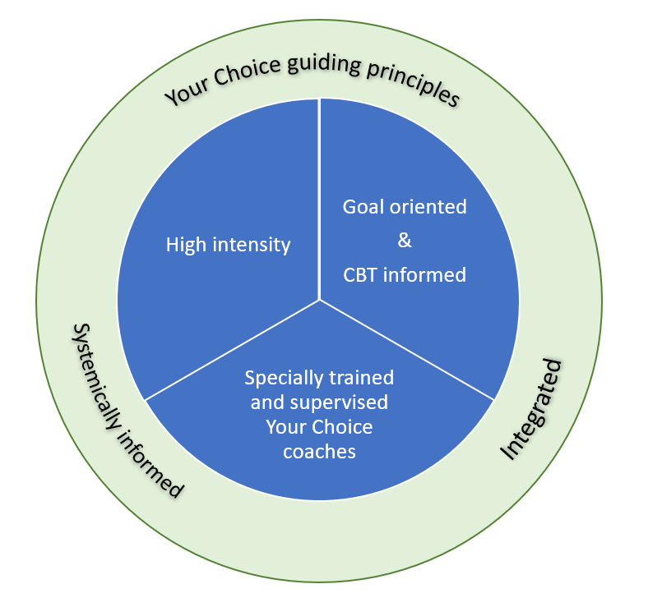

The importance of supervision

Slide 53

The importance of supervision
Your Choice practitioners attendance at Clinical Supervision is a critical part of the Your Choice programme. There are a number of functions that Clinical supervision serves, which includes;
  To support Your Choice practitioners to creatively apply and adapt their training, to the needs and preferences of the young person and within their professional competence.
  To ensure that practitioners are supported to escalate, signpost or refer for additional support when a young person’s needs appear beyond their professional competence or service capabilities.
  To consider and review individual formulation to ensure appropriate matching of tools and techniques.
  To stay alive to cultural considerations for both young people and practitioner and consider how this may be impacting on engagement and progress.
  A dedicated space to consider the impact of exposure to other people’s trauma.
  A place to consider how Your Choice is integrated with existing plans including risk and safety plans, plans for ongoing intervention and appropriate referrals as necessary.

Slide 54
How to run a session
  Get to know each other and get going on goals with young person
          Reflect as you go. What are you noticing as you are moving through activity?
          SeekOpportunities to weave in tools and techniques
  Who else can support young people to work towards their goals this week?
  Track goals on goal tracker
  How can you build on strengths for next session?
Notes:
Encourage GROWTH- a helpful acronym to help frame Your Choice sessions. This will also be helpful to share with Your Choice buddies.

Slide 55
Managing risk and vulnerability
It is important that Your Choice is integrated with existing plans so that Your Choice can inform and be informed by appropriate risk and safety planning.
It is therefore important that you employ your existing principles of practice, specifically around principles of confidentiality to ensure that young people are aware how and when you will share information about them.
Notes:
It is therefore important to ensure that you employ all of your existing practice principles in relation to principles of confidentiality to ensure that young people are aware of how and when you will share information about them.

Slide 56
Managing risk and vulnerability
How would the Your Choice programme link with the wider intervention plans
How would Your Choice contribute to risk and safety management plans?
Notes:
Some prompts
i) How might other plans link to young person’s overarching goals/ aspirations?
How might Your Choice sessions count towards statutory visits/ requirements?
ii)Enabling pro social activities
Activates pro social networks
Builds on young person’s strengths

Slide 57
Preparing for Day Four
The next training session will provide an opportunity to reflect on your "Your Choice" journey so far; to share what’s been working well, identify some of the challenges and plan ahead.
You will be asked to bring a case to present to your colleagues, share good practice and troubleshoot any identified obstacles.
During this session you will also be looking at ways to collate and present a Me Manual (a manual capturing all that they have learnt about themselves) that the young person can take with them at the end of the programme.

Slide 58

Exercise to end the day. Guided Imagery.
This exercise encourages you to build a safe place in your mind and practice going there. With practice, this exercise can help you to step away from difficult memories or feelings and focus your imagination on things that are calming, supportive and safe.
Can you bring to mind a time or a place when you felt safe or calm. If so, where was this? Close your eyes and try to recall as much detail about what you could see, what you hear, feel, sense, taste. Don’t worry if not, we can use your imagination to build one. Some ideas for such a place in your imagination might be;
  Beach, mountain, lake, forest, park, your favourite place, on a boat, a computer game, on a spaceship.
Notes:
Exercise to end the day right and one that you can think about weaving in to your sessions with young people.

Slide 59

Guided imagery
Imagine yourself sitting on a warm hidden beach, with the soft sand under foot and the warm sun on your face, the calming sounds of the waves and the salty sea air. Notice what happens.
The pictures we create in our heads impact on how we feel. For example imagine being in a small boat in the middle of the sea, surrounded by huge sharks and there is a leak in the boat. You are sinking whilst the sharks get closer and closer. It is likely that this leaves you with a feeling. In the same way we can create safe spaces in our heads using guided imagery. This too will have an effect on our body and emotions.
© LIIA (London Councils) 2022. All rights reserved.​
These materials may not be reproduced or distributed other than in accordance with the Your Choice Programme, without express permission
Notes:
You may wish to ask willing coaches to share their image and ask them to share detail using the next slide.

Slide 60
Guided imagery. The finer details.
What can you see there? What can you hear? What can you taste? What can you touch or feel? What kind of light is there? Is it cold or warm? Can you find a body position that feels comfortable there?
You can invite imagined helpers there but these need to be safe people who help you to feel safe and calm.
Pay attention to the scene- are you happy with the detail? If not change it. This is your place. You are the creator and in control of the scene.
Invent a way for accessing this place in your mind that will allow only you to enter. This could be a secret password or complicated lock.
Then practice going there often. It will help to keep you calm but also makes it easier to get to your safe place when you need it most and you need some space from intense or distressing feelings or thoughts.
It is possible to choose a calming piece of music to listen to if you really can’t imagine a safe place in your mind.
© LIIA (London Councils) 2022. All rights reserved.​
These materials may not be reproduced or distributed other than in accordance with the Your Choice Programme, without express permission

Slide 61

End of Day 3
Notes:
Arrived at end of day.
Check out with trainees.
What are their key take home’s from today’s session.
What has worked well in supporting your learning?
What would help to support your learning needs in Day 2?
What are they looking forward to on Day 2?

