Slide 1

Day 4
Notes:
Welcome to Day 4.

Slide 2
Welcome back
Check In
  Applying theory to practice- questions?
  Overall what’s working well?
  Overall what have some of the challenges been?
    How have you overcome these?
  Any creative adaptations to the exercises presented?
  How have you been able to embed the Guiding Principles?
Notes:
Start Day 4
What do you need from trainer to support today’s reflective session?
What do you need from each other to support today’s reflective session?

Slide 3
Learning objectives Day Four
To reflect together on putting theory to practice?
To hear case examples of where things are going well.
To utilise peer support to problem solve to overcome obstacles.
To re-visit preparations for endings.
To consider creative ways of developing a young person’s manual/ guide.

Slide 4



5 finger breathing technique
Place your pointing finger onto the opposite pinky finger.
As you breathe in trace up to the top of the pinky finger and as you breathe out trace down to the bottom of the pinky finer.
Repeat for all your fingers until you get to the bottom of your thumb.
Breathe in
Breathe out
Notes:
Start with breathing exercise- or another grounding exercise of your choice.

Slide 5

Case presentations
  Brief background of young person.
  Have you identified a hook?
    How did you spot this?
    How are you using this to engage?
  What goals have you identified?
  What exercises have you found useful
  What obstacles have you come across?
    How have you overcome these?
    Do you foresee any in the future? How would you tackle these?
  How have you embedded the Guiding Principles?
  What are your next steps?
  How will you ensure that the young person’s interests and goals will be able to continue after completion of the programme?

Slide 6
Case presentations
Stuck cases
  Brief background of young person
  Where have you got stuck?
  What is your understanding of the obstacle?
    & the young person’s?
  How do you plan to address these?
  How could your fellow "Your Choice" coaches help?
Notes:
Feel free to add any other case discussions based on themes from the check in.

Slide 7
Preparing for the ending.
A reminder.
Promoting effective endings.
The following is encouraged to promote positive outcomes
  Having a mutual discussion about how things went
  Discussing the young person’s future functioning and coping
  Helping the young person use new skills beyond the programme
  Framing personal development as an ongoing process
  Anticipating post-therapy growth
  Talking specifically about what it means to end the programme
  Reflecting on young person’s gains
  Expressing pride in the young person’s progress and in the mutual relationship.
Norcross, 2017

Slide 8
Preparing for the end of a "Your Choice" intervention.
It is hoped that at the end of the programme young people will have developed a deeper understanding of themselves; what’s important to them, how they process things, what they enjoy doing, how to live a meaningful life and strategies for overcoming obstacles.
Capturing this somewhere, somehow, so that they can refer to it will provide a resource that they can refer to when they have completed the programme.
Throughout the course of the programme it will be important to be preparing for the longer term, to ensure that there is a plan for young people to continue with their interests and goals in their communities after completion of the programme.

Slide 9

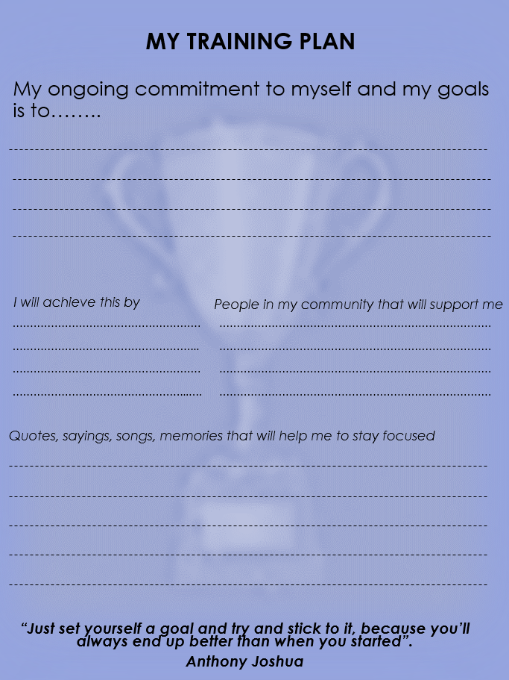
Remember to complete the Young Person’s Training Plan as you prepare for the end of the programme.

Slide 10
Guide to me
My goals
What/ who is important to me (my values)
Keeping my thoughts in order (my thinking traps)
My active life (positive/ pleasurable activities)
Keeping myself in check (emotion regulation exercises that work for me)
Where to go if need support or want to continue your discovery journey.
Notes:
Sometimes referred to Relapse prevention in the clinical world, we want young people to have a place to gather their new learnings about themselves. This will be something that they can refer to or share with people that they think will be important to understand them well.
A suggested structure for this is as follows: You are encouraged to be as creative as possible.

Slide 11
Time to get creative…
My goals
What/ who is important to me (my values)
Keeping my thoughts in order (my thinking traps)
My active life (positive/ pleasurable/ purposeful activities)
Keeping myself in check (emotion regulation exercises that work for me)
Where to go if need support or want to continue your discovery journey.
Notes:
In pairs come up with as many suggestions of how to make this creative/ accessible as possible. You could always ask coaches to create their own personal my manuals and provide creative materials to support them to do this.

Slide 12


How to become a certified Your Choice Coach
Your Choice recognises that learning only begins in the training room and that developing new skills requires effective consolidation by applying them in professional practice. Your Choice coaches are, therefore, required to participate in monthly supervision to support their ongoing learning and professional development.
To become a certified Your Choice coach you must complete and evidence the following in your logbook;
  4 days Your Choice Training
  Your Choice Quiz
  Attendance at 4 supervision session
Once complete, coaches should present logbooks to their trainer who will issue Your Choice certificate, which we are hoping will be approved as part of the British Psychological Society kitemark scheme.

Slide 13

On a scale of 0-10 how confident are you in delivering a CBT informed intervention that focused on behavioural activation to young people?
Notes:
You may wish to use post it notes- with name so that you can compare with pre scores at the end of the training.
Don’t forget to send results back to the Your Choice central team. yourchoice@liia.london

Slide 14

Quiz for Coaches click here

Slide 15

Please complete evaluation form via link
Notes:
Please ensure that your trainees complete the evaluation using the following link.

Slide 16

End of Day 4
Notes:
Arrived at end of day.
Encourage personal reflections around learning preferences for learners to share with their Clinical supervisors to support their ongoing learning.

Slide 17

Your Choice Inbox: yourchoice@londoncouncils.gov.uk
Dr Karla Goodman (Practice Lead, LIIA): Karla.Goodman@londoncouncil.onmicrosoft.com
Isabelle Gregory (Project Lead, LIIA): Isabelle.Gregory2@londoncouncils.gov.uk
Visit our website:
liia.london
Follow us on Twitter:
@londonliia

Slide 18
References
Brooks, Rob & Lambert, Charlotte & Coulthard, Laura & Pennington, Lindsay & Kolehmainen, Niina. (2021). Social participation to support good mental health in neurodisability. Child Care Health and Development. 47. 10.1111/cch.12876.
DeAngelis, T. (2019, November). Better relationships with patients lead to better outcomes. Monitor on Psychology, 50(10). http://www.apa.org/monitor/2019/11/ce-corner-relationships
Ekers, D., Webster, L., Van Straten, A., Culipers, P., Richards, D., & Gilbody, SM (2014) Behavioural Activation for Depression; An update of Meta-Analysis of Effectiveness and sub group analysis. PLoS ONE 9(6): e100100. https://doi.org/10.1371/journal.pone.0100100
Howard A. P (2015). DBT Skills Manual for Adolescents, by J. H. Rathus & A. L. Miller, Child & Family Behavior Therapy, 37:2, 179-187, DOI: 10.1080/07317107.2015.1035996
Padesky, C. A., & Mooney, K. A. (1990). Clinical tip: Presenting the cognitive model to clients. International Cognitive Therapy Newsletter, 6, 1.
Plutchik, R. (2001). The nature of emotions: Human emotions have deep evolutionary roots, a fact that may explain their complexity and provide tools for clinical practice. American scientist, 89(4), 344-350.
Sweeney, A., Clement, S., Filson, B & Kennedy, A (2016). Trauma-informed mental healthcare in the UK: what is it and how can we further its development? Mental Health Review Journal 21 (3) pp. 174-192
Thompson, S. J., Bender, K., Lantry, J., & Flynn, P. M. (2007). Treatment Engagement: Building Therapeutic Alliance in Home-Based Treatment with Adolescents and their Families. Contemporary family therapy, 29(1-2), 39–55. https://doi.org/10.1007/s10591-007-9030-6
Tseng, J., Poppenk, J. Brain meta-state transitions demarcate thoughts across task contexts exposing the mental noise of trait neuroticism. Nat Commun 11, 3480 (2020). https://doi.org/10.1038/s41467-020-17255-9
Young Minds (2018). Addressing adversity. Prioritising adversity & trauma informed care for children and young people in England. The YoungMinds Trust with Health Education England https://www.youngminds.org.uk/media/cmtffcce/ym-addressing-adversity-book-web-2.pdf

Slide 19
Some useful reference links
Addressing issues of race, ethnicity and culture in CBT to support therapists and service managers to deliver culturally competent therapy and reduce inequalities in mental health provision for BAME service users | the Cognitive Behaviour Therapist | Cambridge Core
https://www.powerthefight.org.uk/wp-content/uploads/2020/09/TIP-final-report-executive-summary.pdf
https://www.psychologytools.com/
https://www.therapistaid.com/therapy-worksheets
https://www.youngminds.org.uk/

Slide 20





With thanks to our funders
& evaluators

