Slide 1
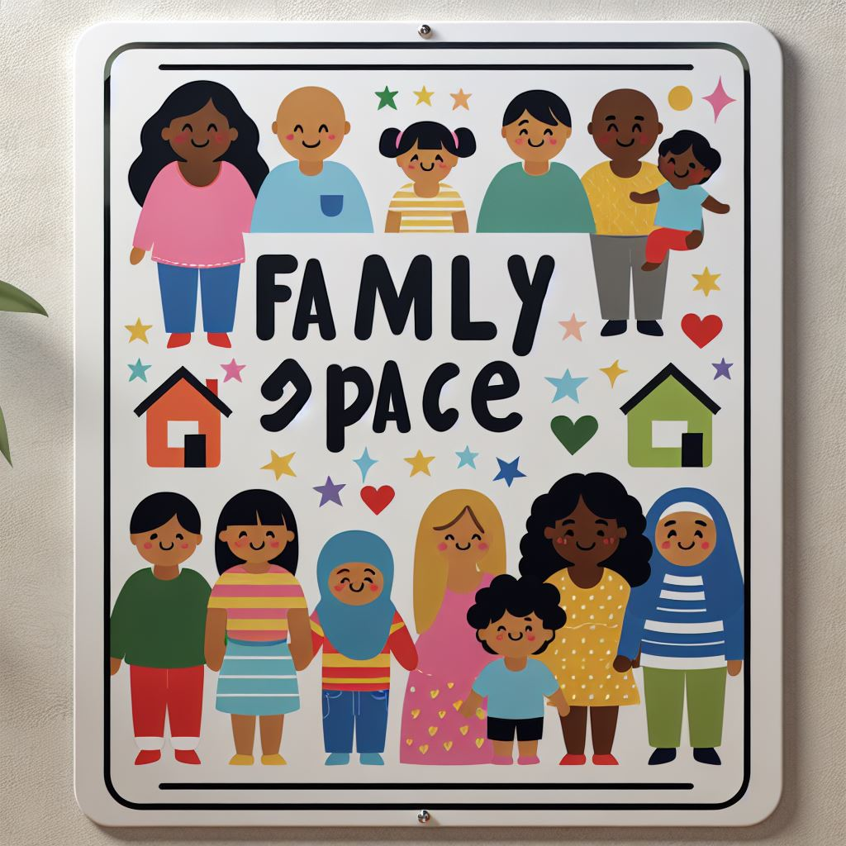


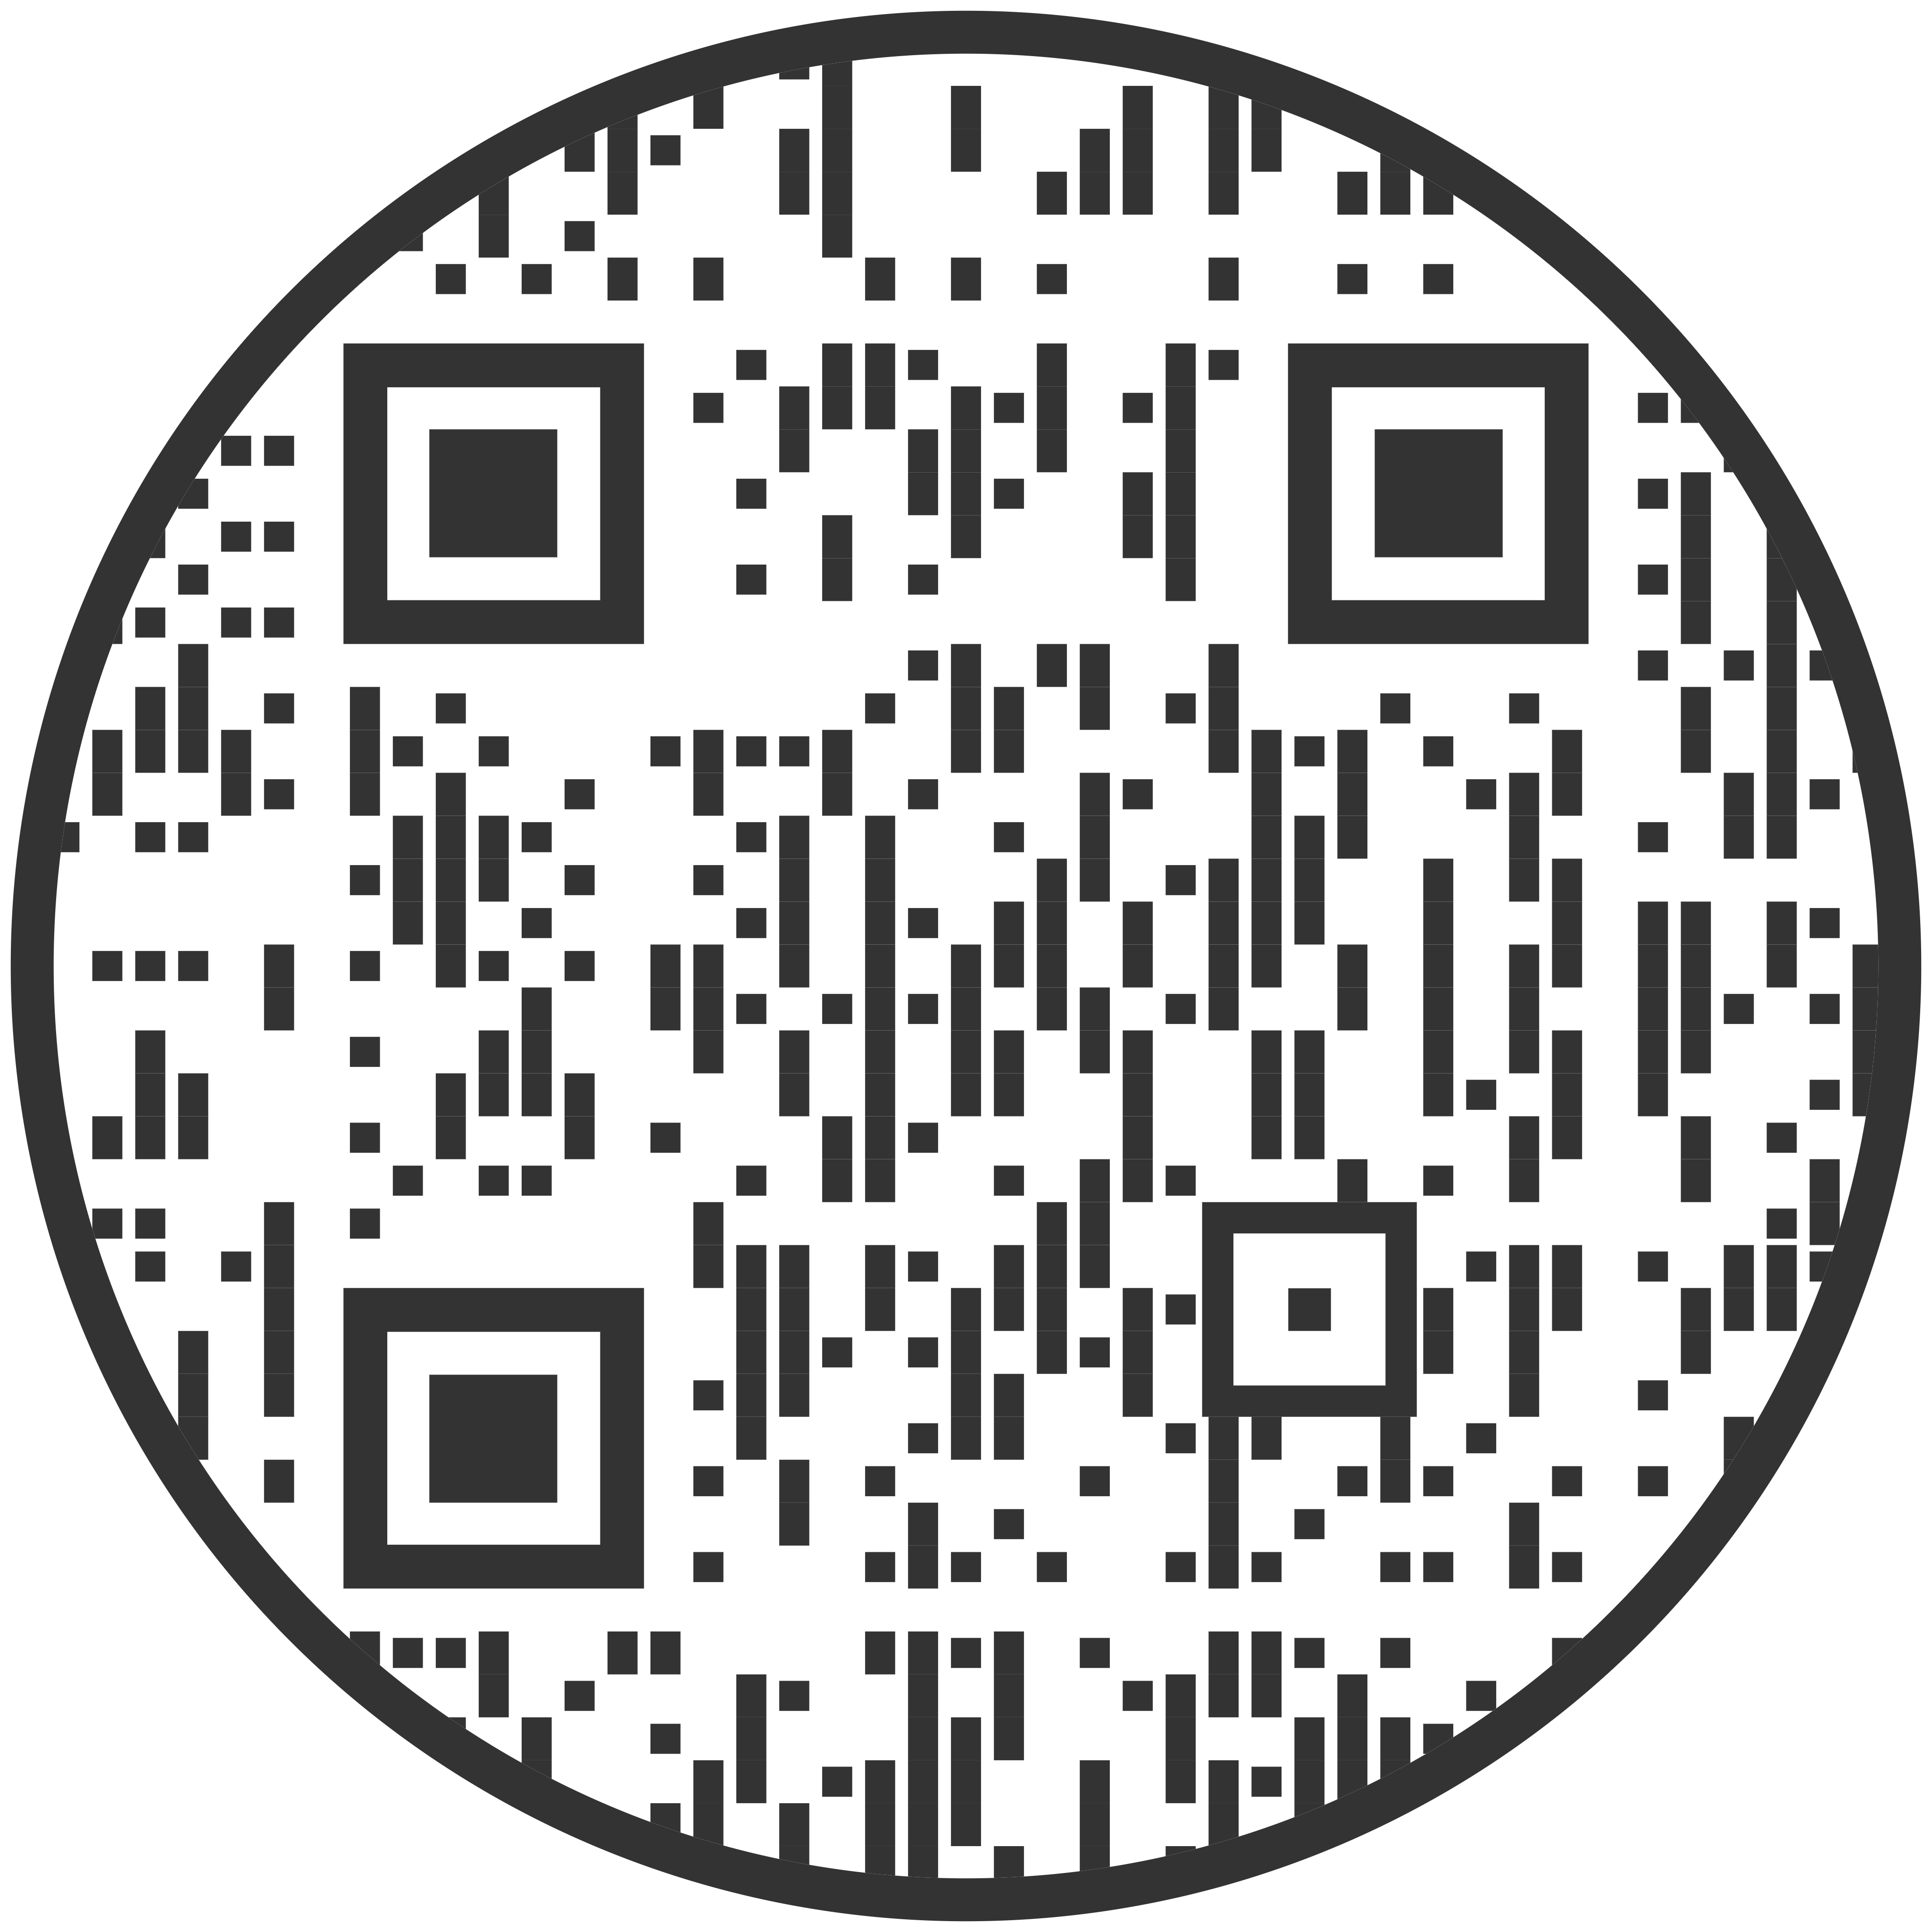
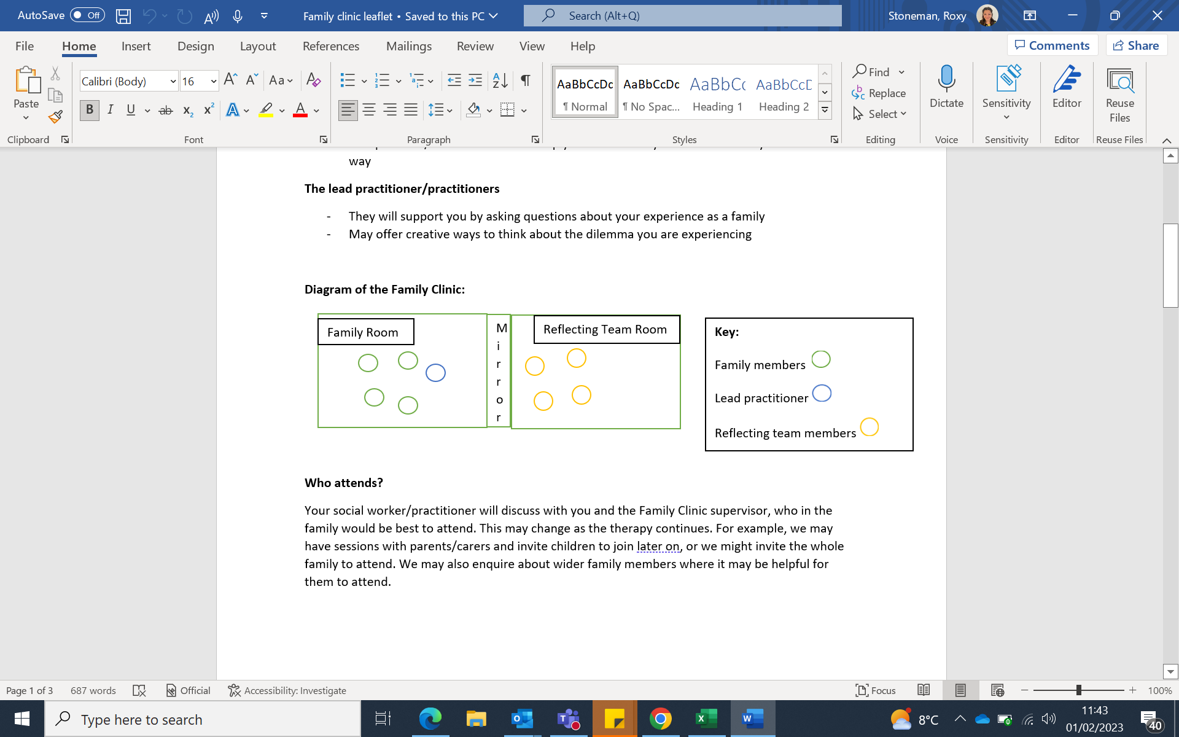
Family Space puts families at the heart of decision making. We know families are the experts of their lives and that sometimes a little extra help is needed to improve a child’s safety or development, family relationships, and family happiness. Family Space is not family therapy - however, the team are led by a Family Therapist and take a family therapy approach. We meet fortnightly for a set number of sessions.
The Room
How it works
Scan for directions →
You’ll have a conversation with a practitioner in the Family Room.
The Reflecting Team and Family Therapist will observe from next door.
The Family Therapist may call in with suggestions during your conversation.
The Reflecting Team will join half-way through to share their ideas.
What is expected of me and my family?
Attend regularly: If you miss 3 sessions you will lose your space.
Signed consent
The Reflecting Team
Up to 5 people may be in the Reflecting Team.
A Family Therapist leads the team.
They hold various roles in Children's Social Care.
Their goal is to understand your family and offer ideas
Who comes?
How is Family Space linked to the social care plan for my child?
We will make a plan with you about who from your family or community you would like to join. Your allocated worker will also be present.
Family Space fits in your support plan. You will continue seeing your allocated worker outside of Family Space. After each session, we send you a summary letter, which is recorded on your child’s file.
What if my child misses school?
A letter can be provided to explain why your child is missing school.

Slide 2
Consent & Confidentiality
Please tick:
I understand that Family Space is not Family Therapy but that it is led by a Qualified Family Therapist and that the team will use a therapeutic approach to try and help my family.
I understand that Family Space is part of Children Services and that the Reflecting Team are employed in Children Services in various roles: Social Workers, Family Therapy Trainees, Parenting Workers, Early Help Workers, Counsellors, Personal Advisors, and so on.
I understand that Family Space is an intervention offered as part of the Social Care Plan and legal framework my child and family are supported within (i.e., Child in Need Plan, Child Protection Plan, Child Looked After Plan) that is led by my Allocated Worker.
I agree that we have discussed confidentiality. I understand that Family Space have a duty to share information with professionals if they have significant worries about someone’s safety, and that this can be done without my consent. I also understand that information may be shared about what happens in Family Space with
Parent/Carer Name: …………………………………………………………. Allocated Worker Name: ………………………………………….
Signature: …………………………………………………………. Signature: …………………………………………………………………

Slide 3
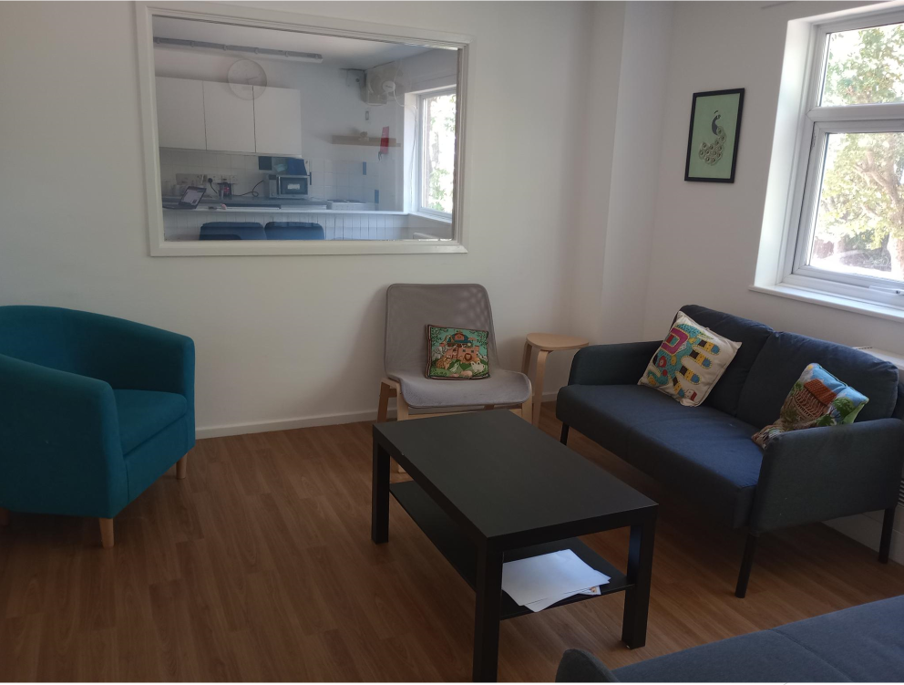
Family Room
The room you will be in whilst you meet with your Allocated Worker and Family Space Practitioner.
We have a range of resources like toys, sensory objects, musical instruments, sand pit, play-do, whiteboard, and so on.
The Reflecting Team are behind the mirror. You can’t see them, but they can see and hear you as you talk.

Slide 4
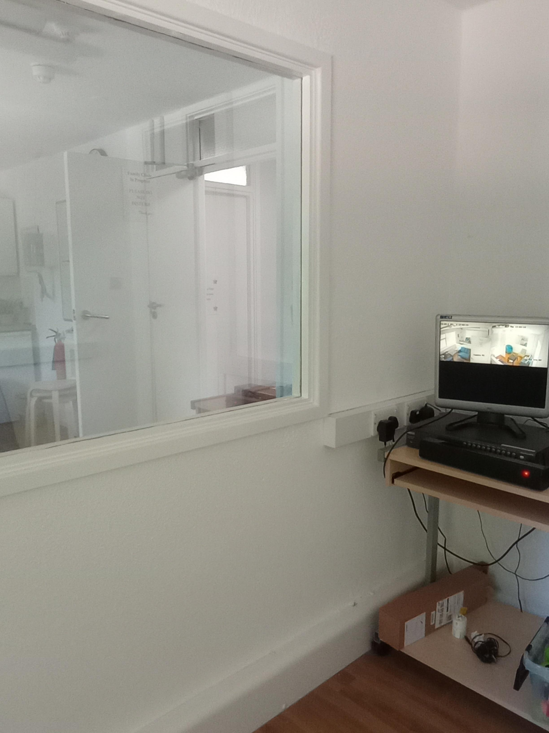
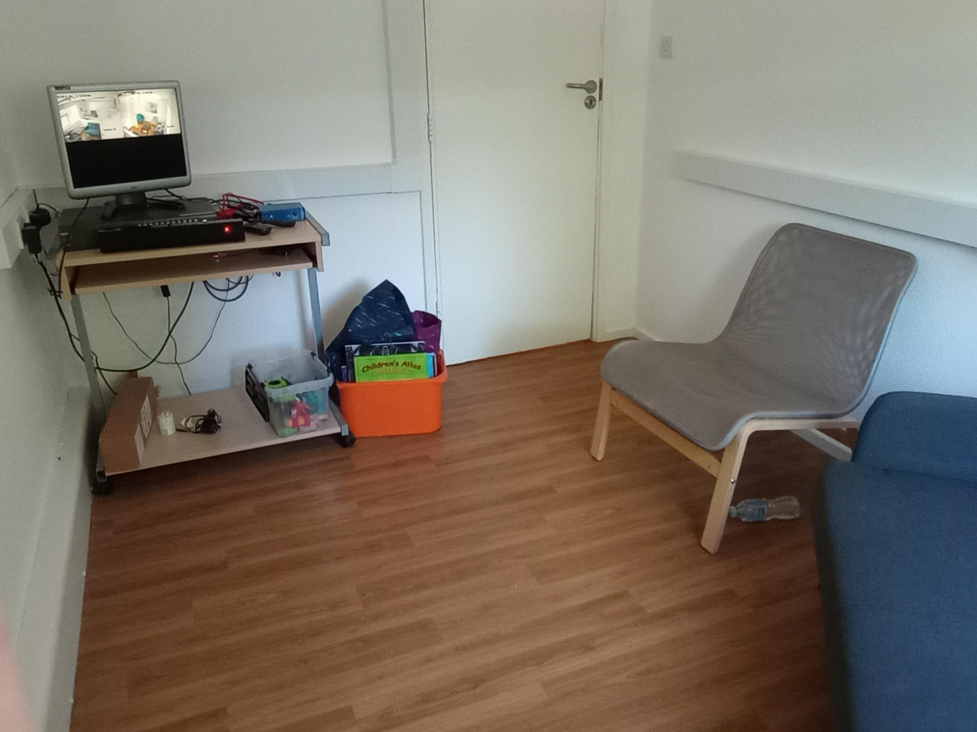
Reflecting Team Room

